Slide 1
Features extraction and classification
November 2024
Andrea Corrado

Slide 2
Outline
Feature extraction
Envelope features
Template matching features
Short time Fourier transformation definition and analysis
Classification
Knowledge based classifier: recap
Improved Knowledge based classifier
Tree classifier: whole set of features optimal subset of features
Conclusions

Slide 3
Outline
Feature extraction
Envelope features
Template matching features
Short time Fourier transformation definition and analysis
Classification
Knowledge based classifier: recap
Improved Knowledge based classifier
Tree classifier: whole set of features optimal subset of features
Conclusions

Slide 4
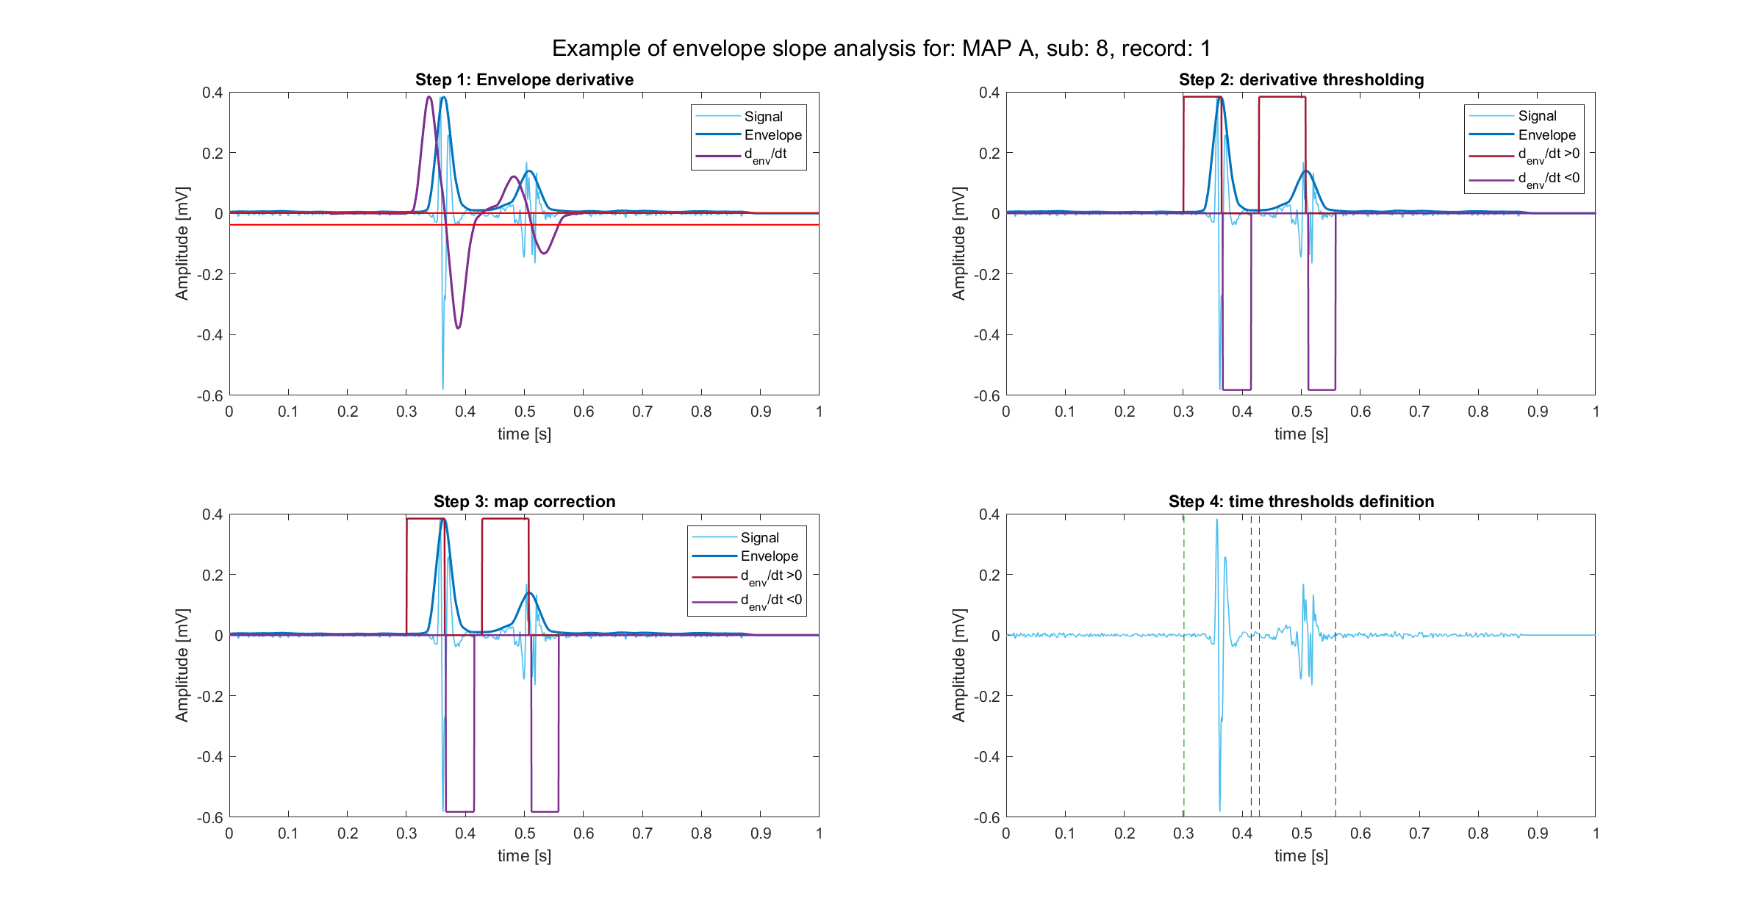
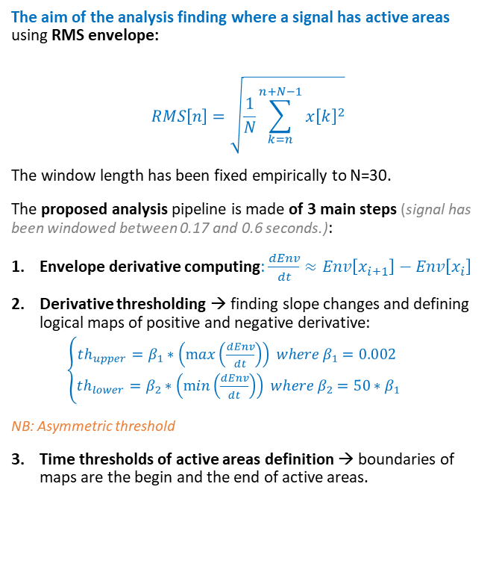
Envelope definition and peak recognition
The aim of the analysis finding where a signal has active areas using RMS envelope:
$$RMS\left[n\right]=\sqrt{\frac{1}{N}\sum_{k=n}^{n+N−1}{x{\left[k\right]}^{2}}}$$
The window length has been fixed empirically to N=30.
The proposed analysis pipeline is made of 3 main steps (signal has been windowed between 0.17 and 0.6 seconds.):
Envelope derivative computing: $\frac{dEnv}{dt}≈Env\left[x_{i+1}\right]−Env\left[x_{i}\right]$
Derivative thresholding → finding slope changes and defining logical maps of positive and negative derivative:
$\left\{\begin{aligned}th_{upper}=β_{1}∗\left(\max\left(\frac{dEnv}{dt}\right)\right) where β_{1}=0.002 \\ th_{lower}=β_{2}∗\left(\min\left(\frac{dEnv}{dt}\right)\right) where β_{2}=50∗β_{1}\end{aligned}\right.$
NB: Asymmetric threshold
Time thresholds of active areas definition → boundaries of maps are the begin and the end of active areas.

Slide 5
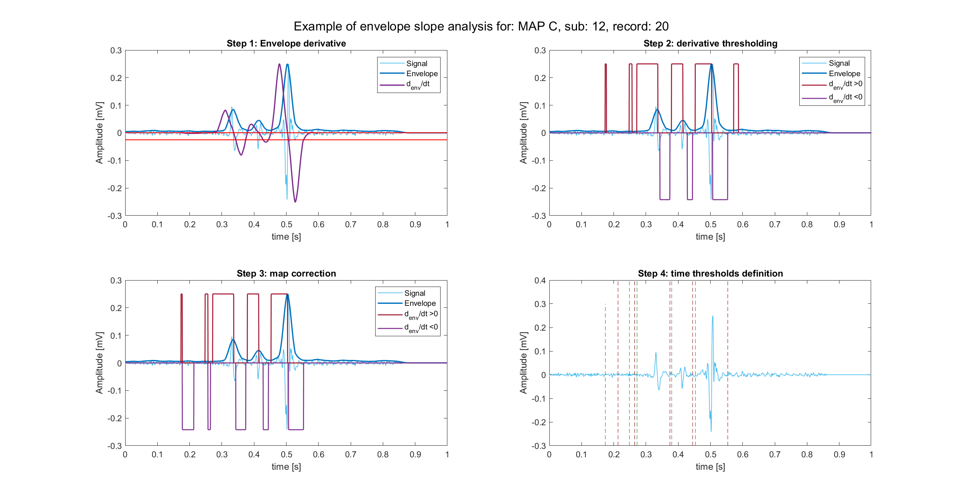
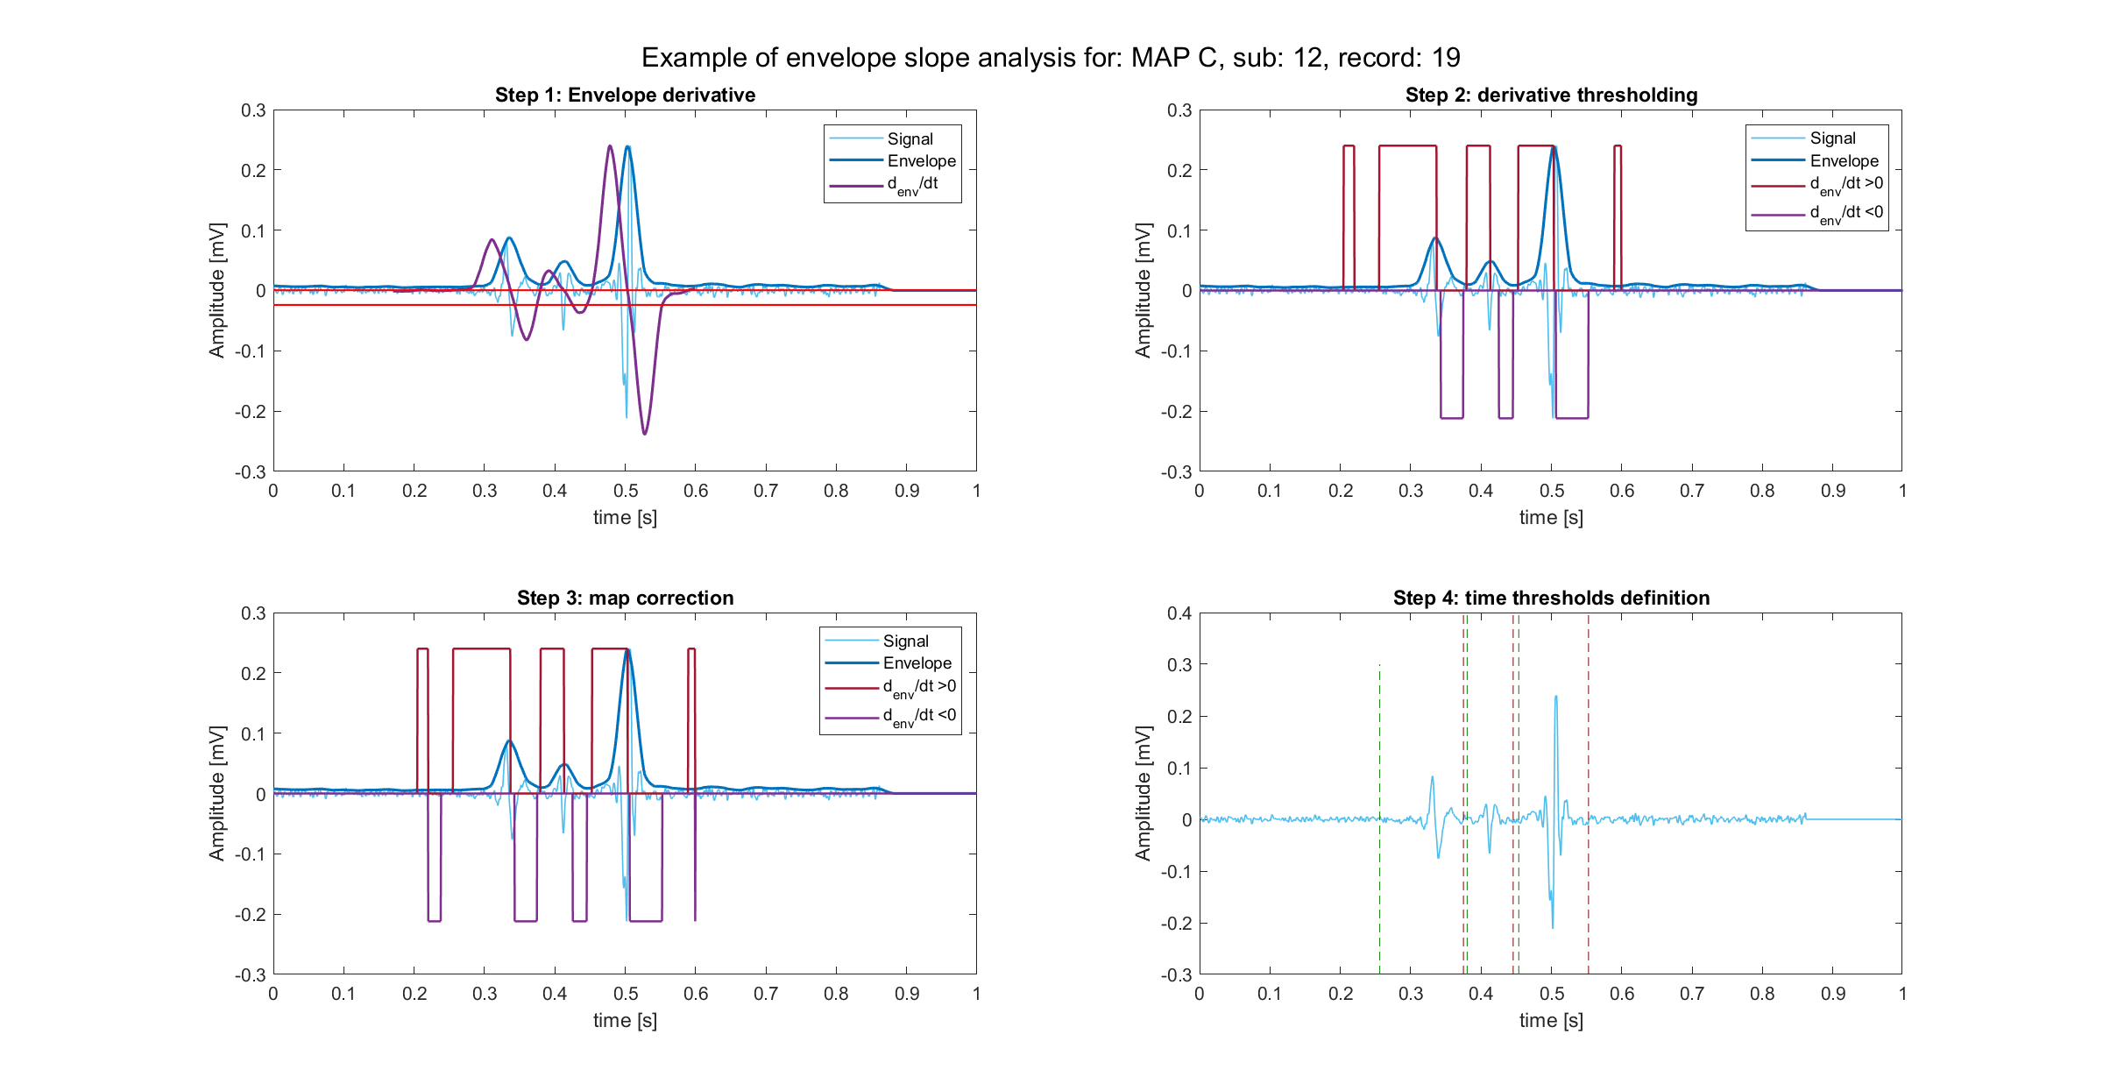
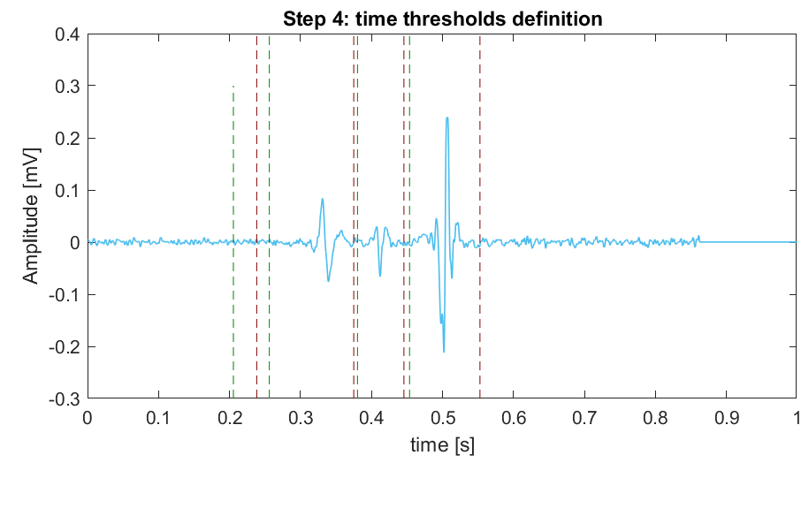
The over-detecting problem
This pipeline has, by building, a peculiarity: active areas are found in superabundance. In fact:
high sensibility of the upper threshold → even noise could be detected as peak → even noise can be seen as “active area”
In other words, this pipeline works with the logic “the higher, the better”. A decisional rule is necessary.
Thus:
True active areas are the ones associated to peaks higher than K=2.5 times the standard deviation of the signal.
After time thresholds cleaning

Slide 6
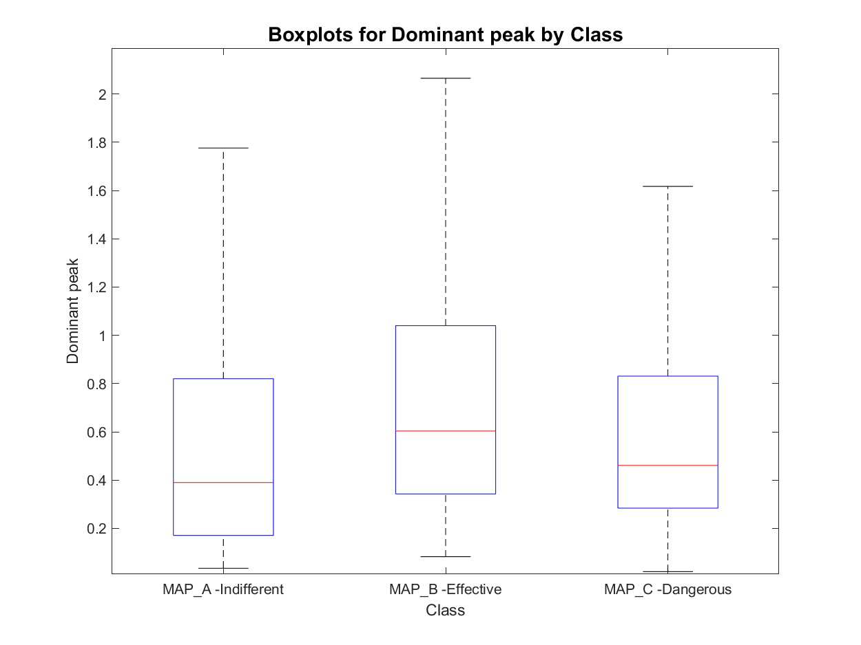
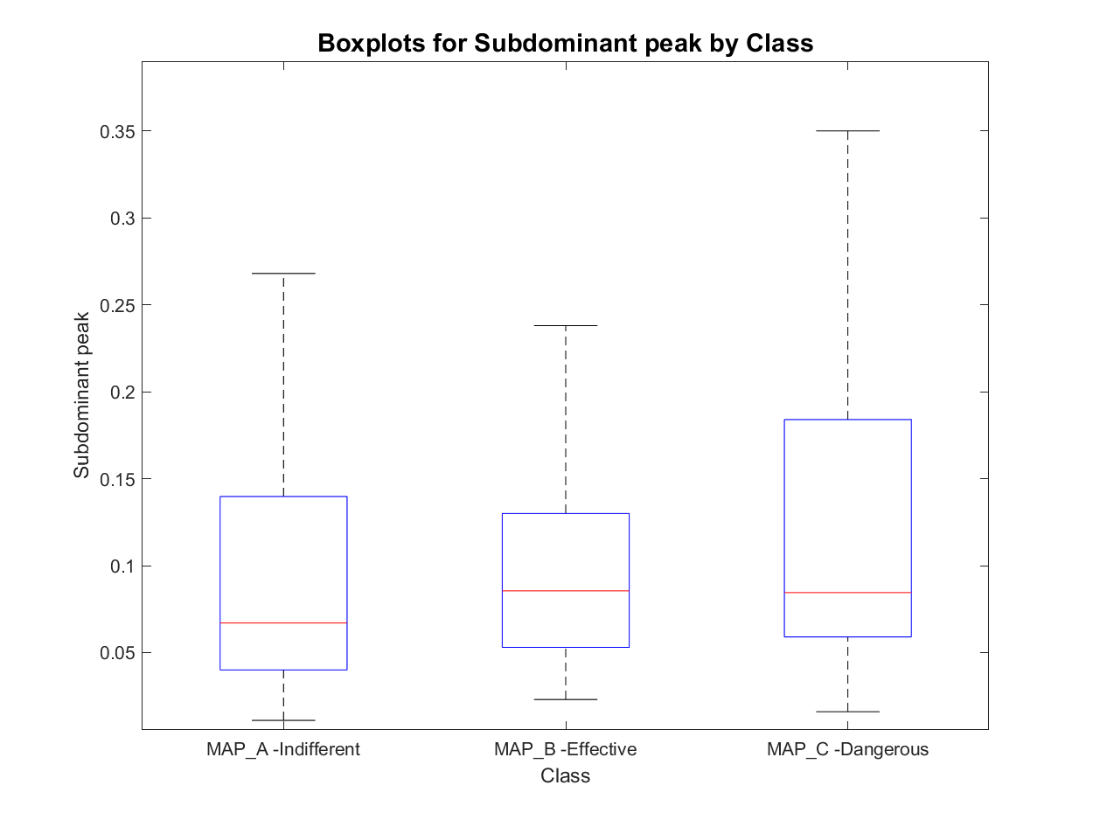
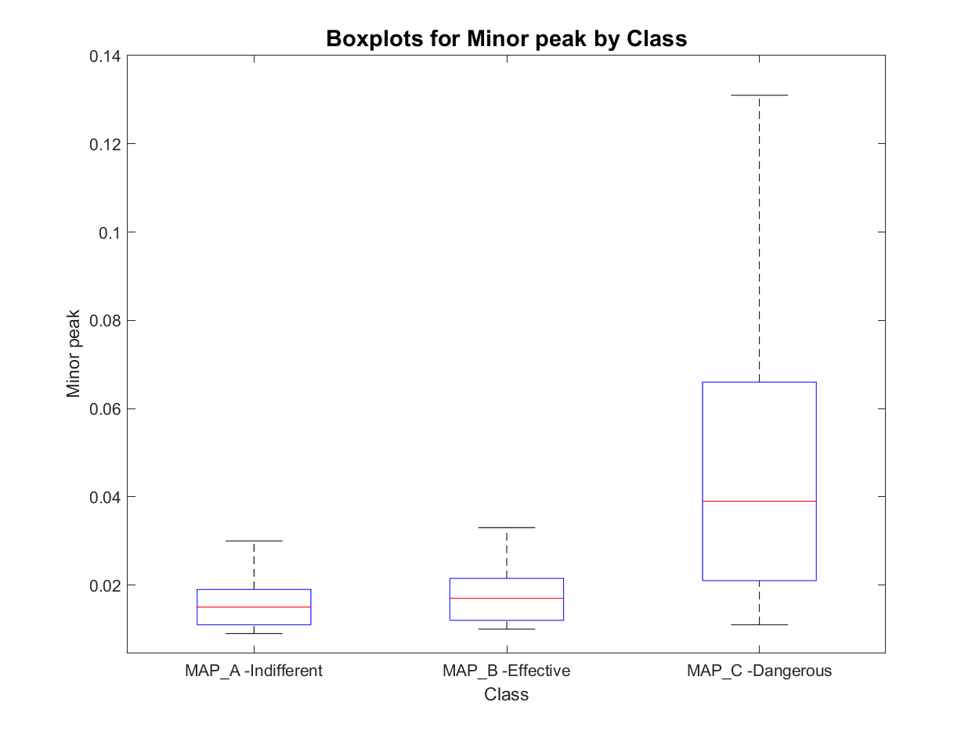
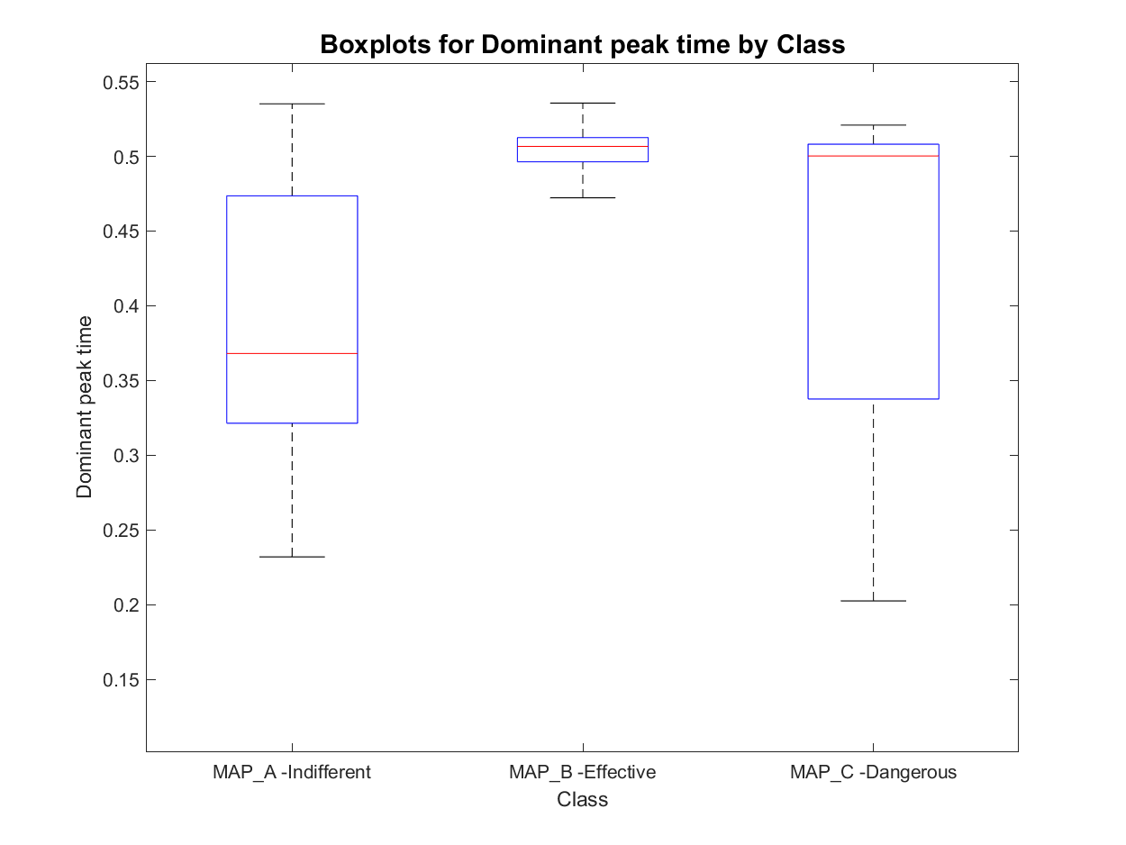
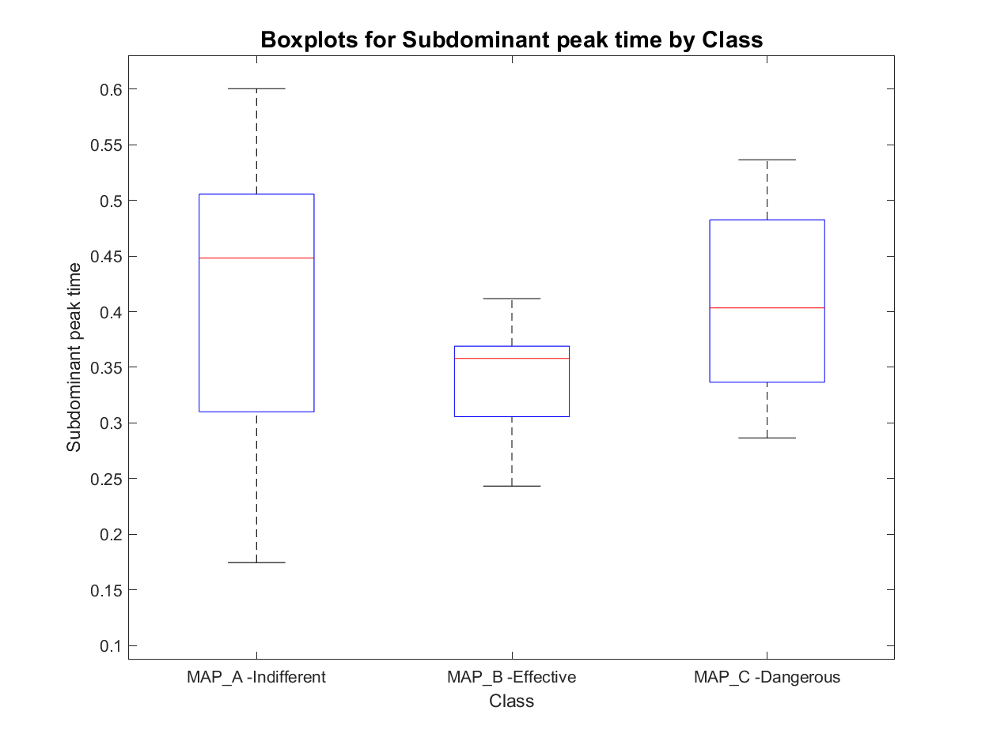
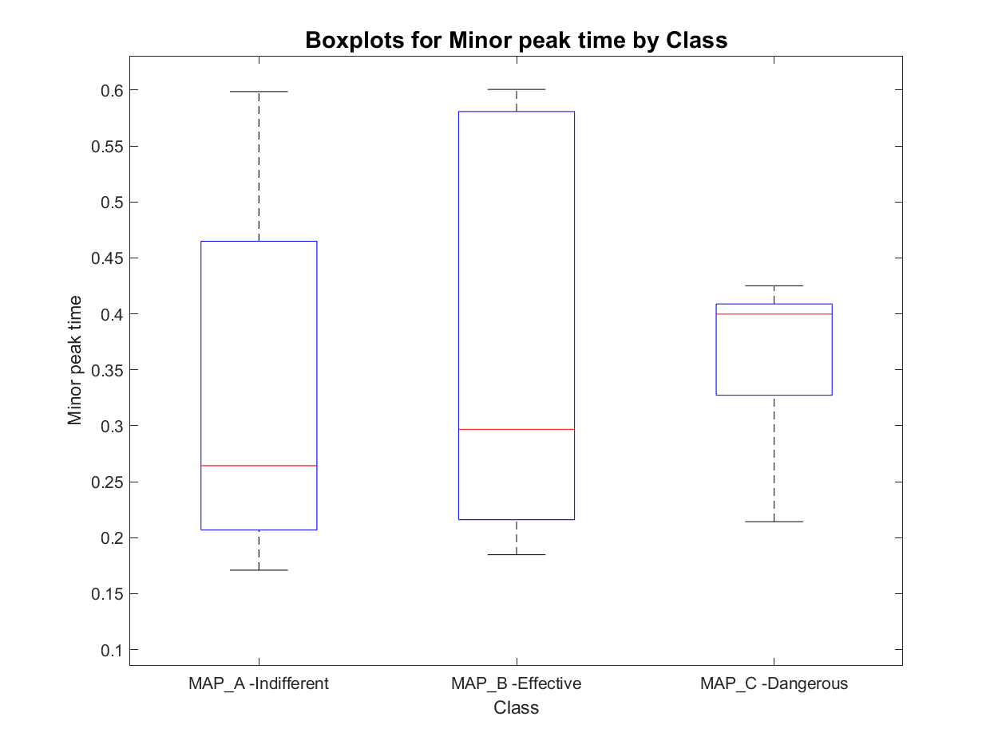
Features set 1.1: signal peak in order of magnitude
MAP_A has:
- 8 signals with one active area
- 452 signals with two active areas
- 180 signals with three active areas
- 23 signals with more than three active areas
total : 640
MAP_B has:
- 0 signals with one active area
- 67 signals with two active areas
- 26 signals with three active areas
- 1 signals with more than three active areas
total : 93
MAP_C has:
- 0 signals with one active area
- 20 signals with two active areas
- 62 signals with three active areas
- 8 signals with more than three active areas
total : 82
Prior Knowledge
Unclear behaviour

Slide 7
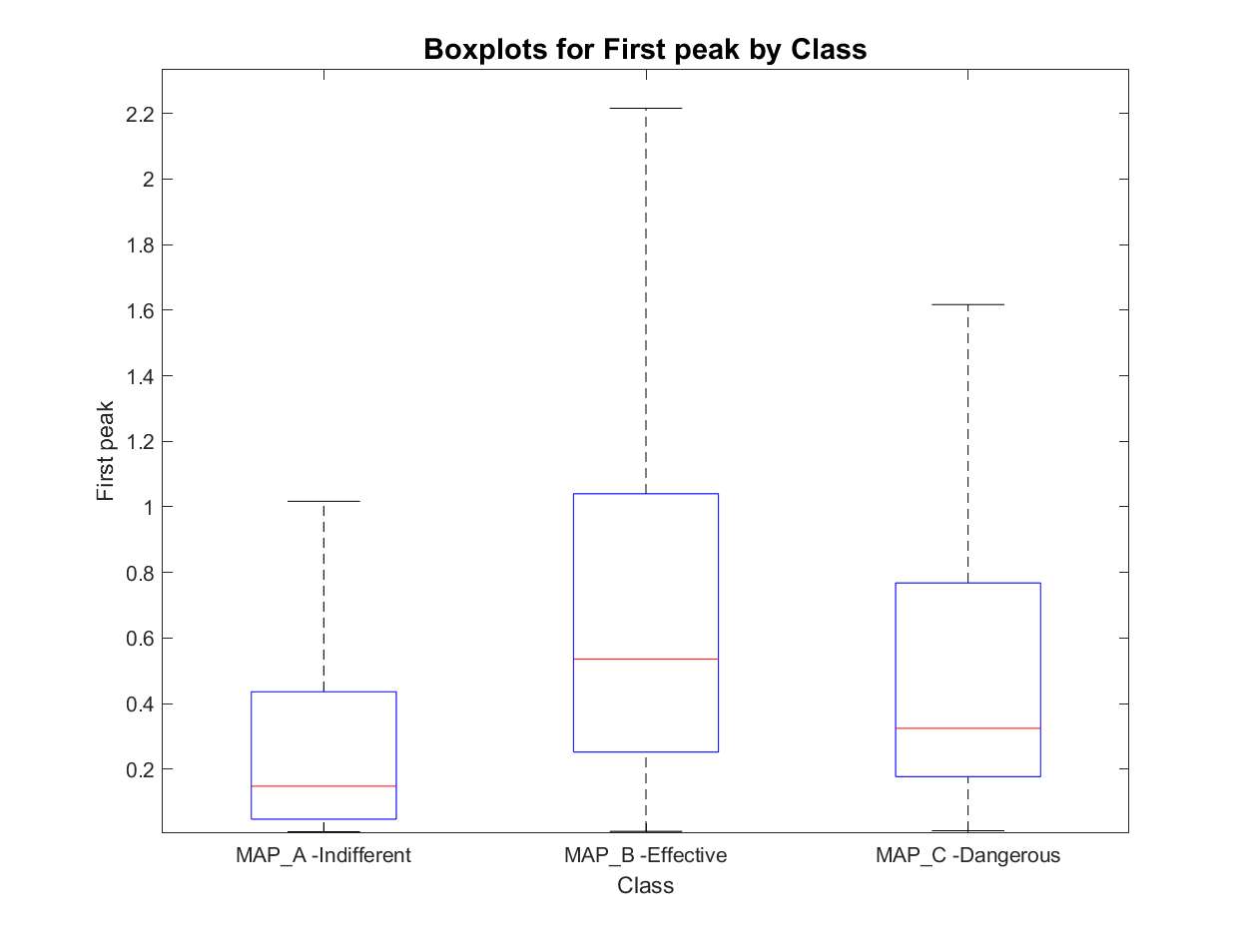
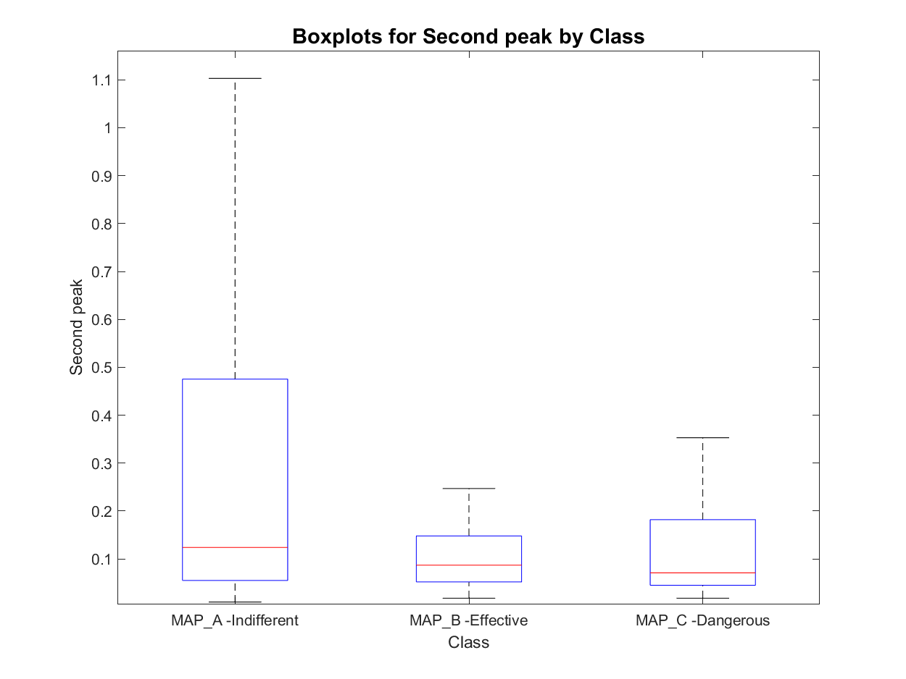
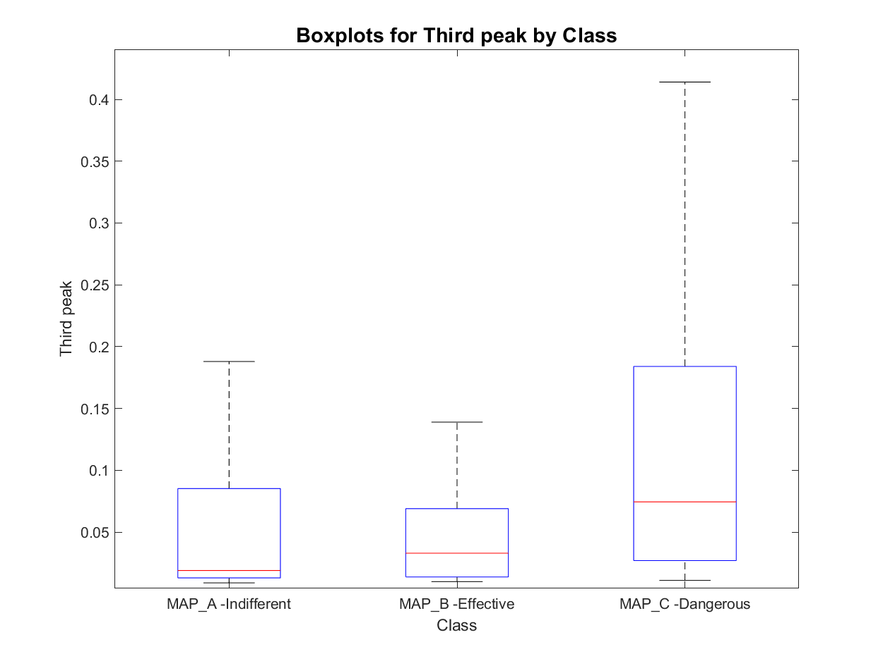
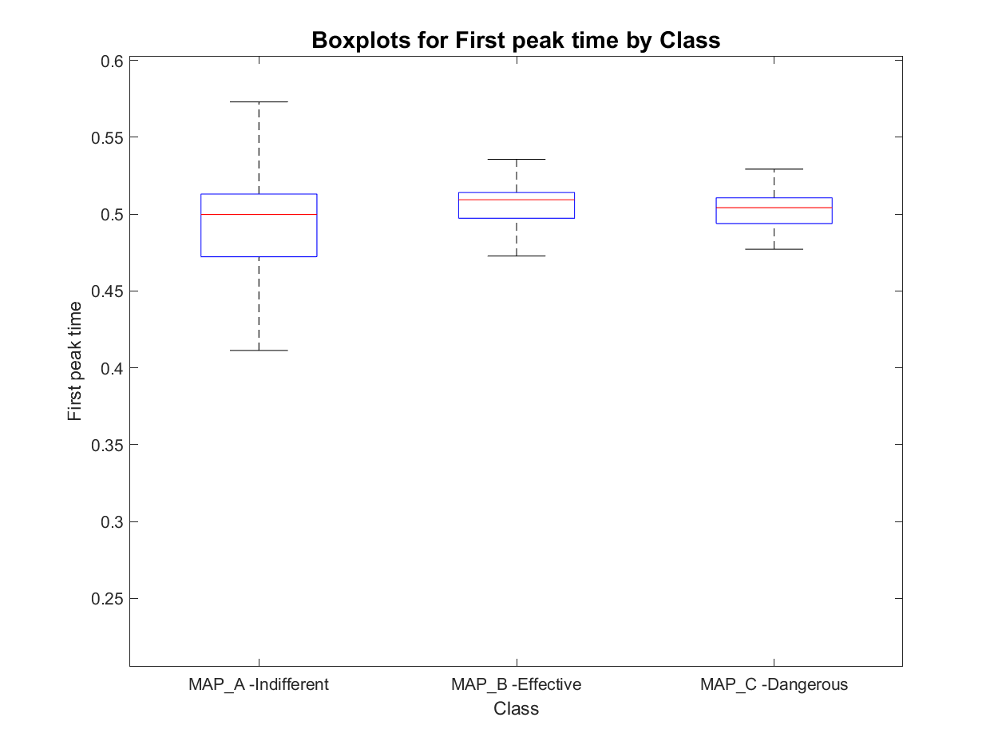
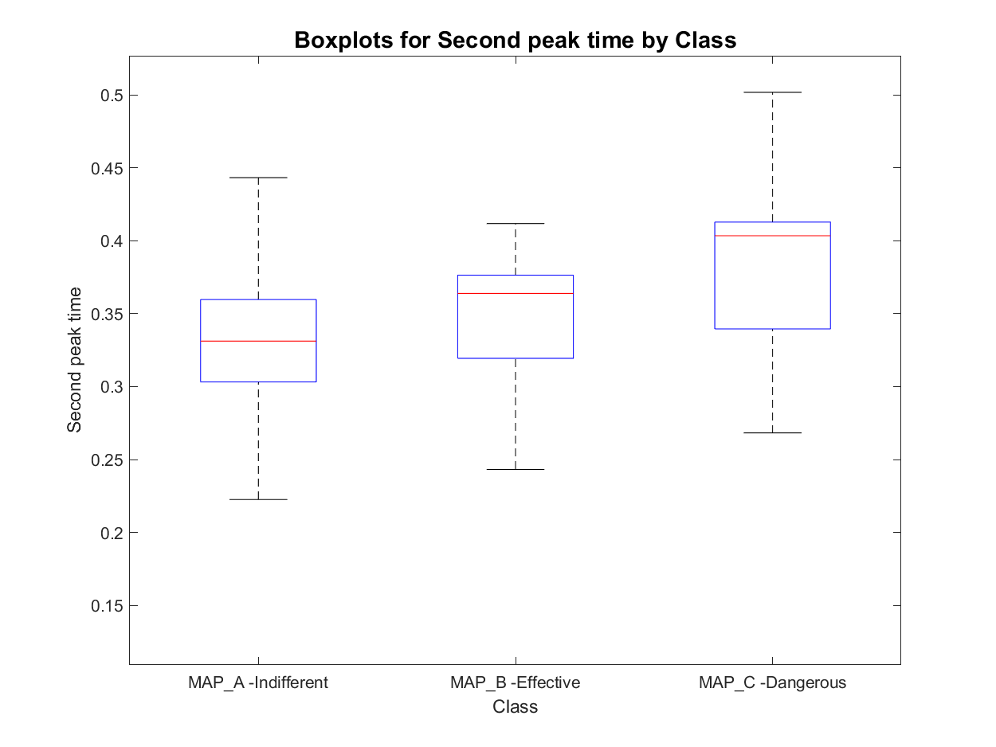
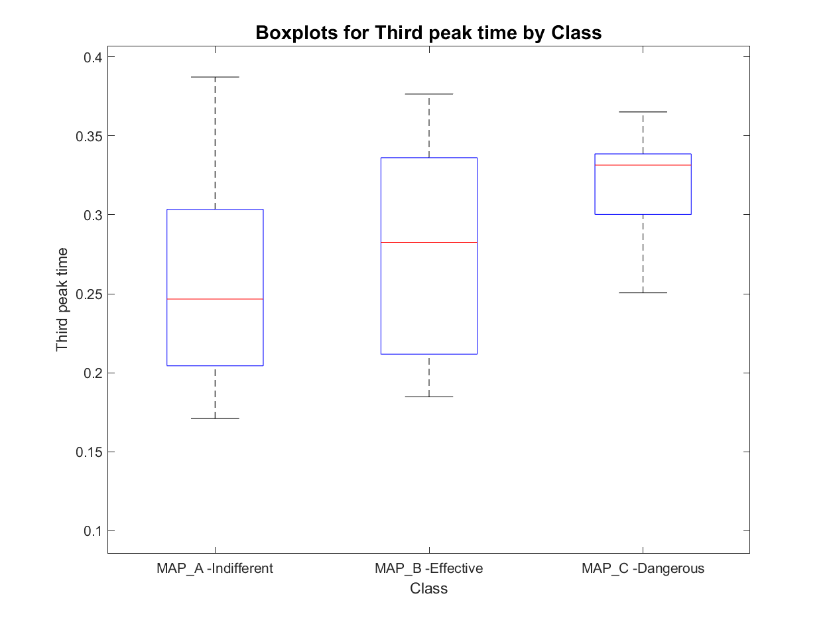
Features set 1.2: Signal peaks in order of time occurrence
MAP_A has:
- 8 signals with one active area
- 452 signals with two active areas
- 180 signals with three active areas
- 23 signals with more than three active areas
total : 640
MAP_B has:
- 0 signals with one active area
- 67 signals with two active areas
- 26 signals with three active areas
- 1 signals with more than three active areas
total : 93
MAP_C has:
- 0 signals with one active area
- 20 signals with two active areas
- 62 signals with three active areas
- 8 signals with more than three active areas
total : 82

Slide 8
Active area analysis: entire set of features
Starting from active areas definition other features have been computed:
Number of active area detected
Signal and envelope peaks absolute values
Dominant, Subdominant, Minor: value and time (6 features + 6 features from envelope signal)
First, Second, Third: value and time (6 features + 6 features from envelope signal)
Duration of active signal
Silent phase within signal duration
Ratios between single features
subdominant to major,
minor to subdominant
Atrial to ventricular peak ratio
Atrial to ventricular peak time ratio
Number of active areas on duration ratio
Silent phase on duration ratio
Number of peaks on duration ratio

Slide 9
Outline
Feature extraction
Envelope features
Template matching features
Short time Fourier transformation definition and analysis
Classification
Knowledge based classifier: recap
Improved Knowledge based classifier
Tree classifier: whole set of features optimal subset of features
Conclusions

Slide 10
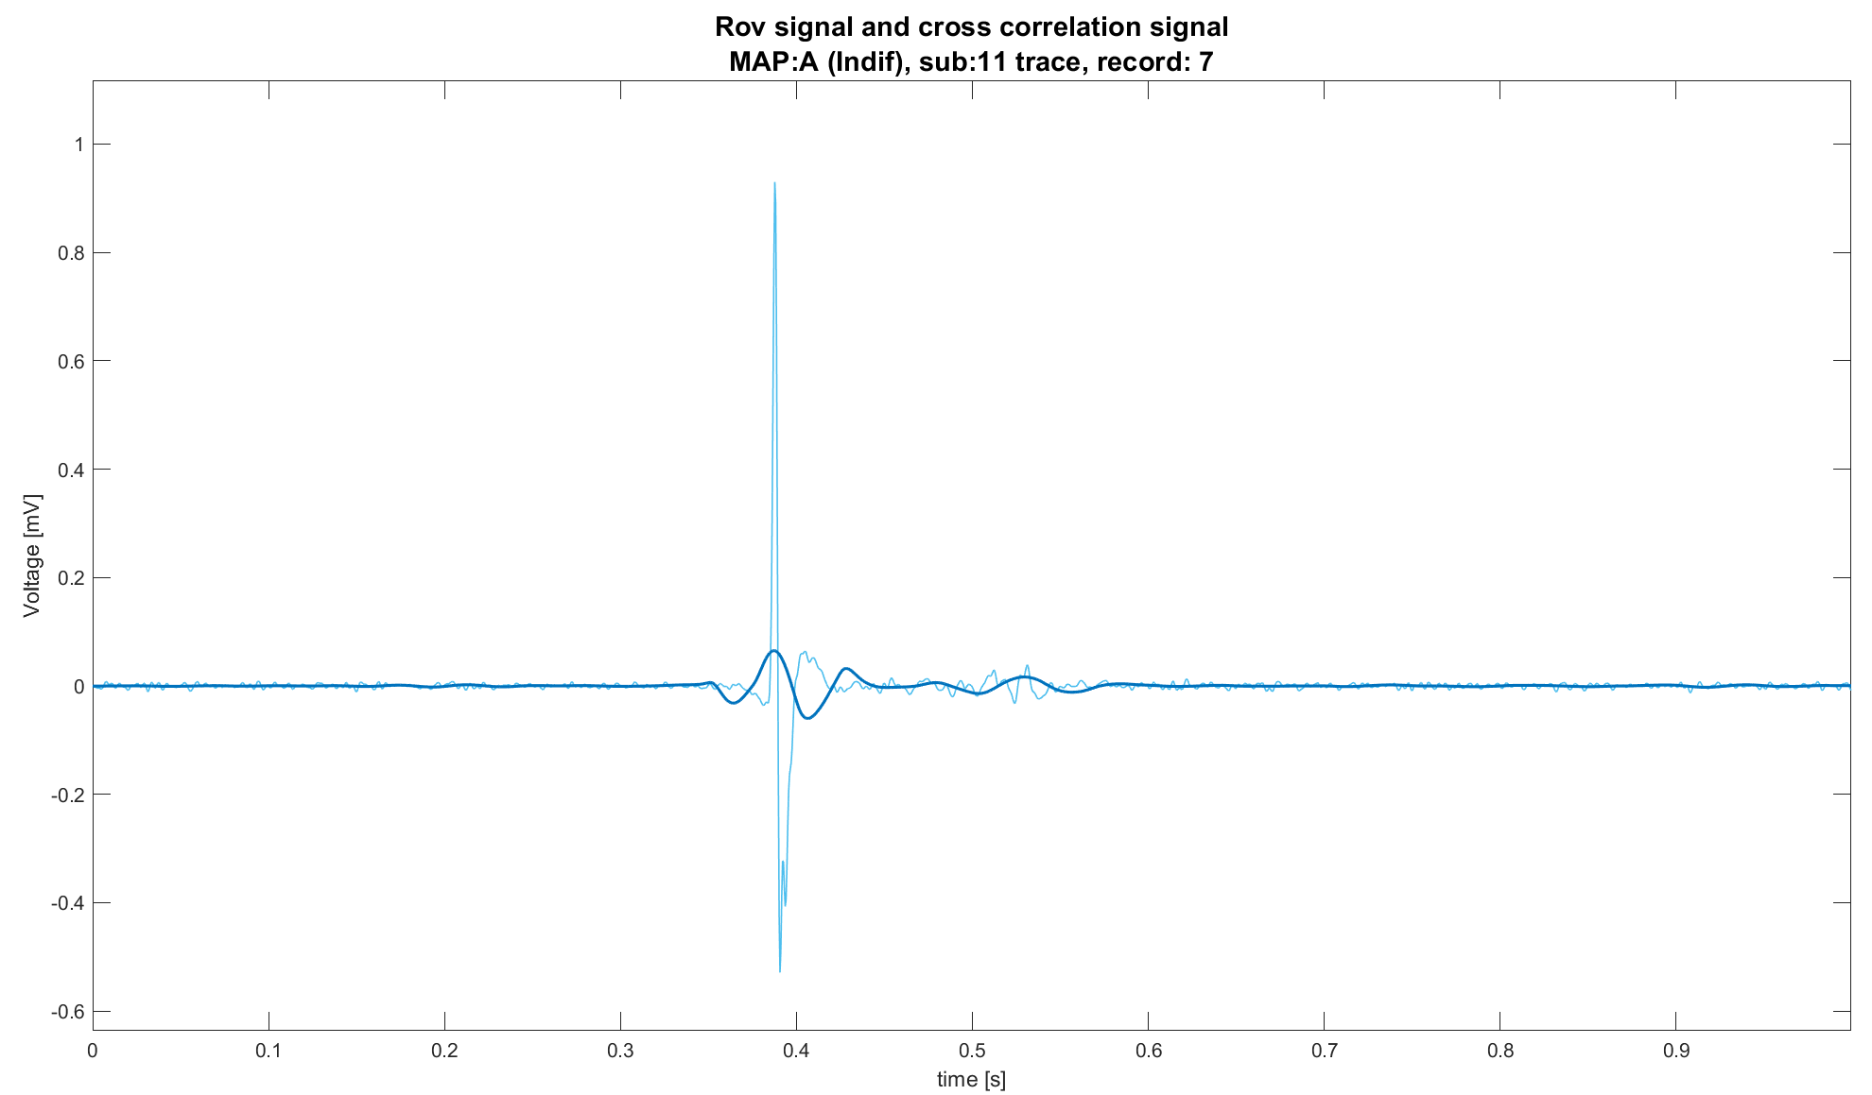
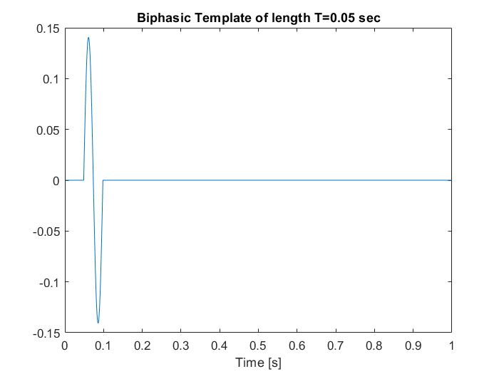
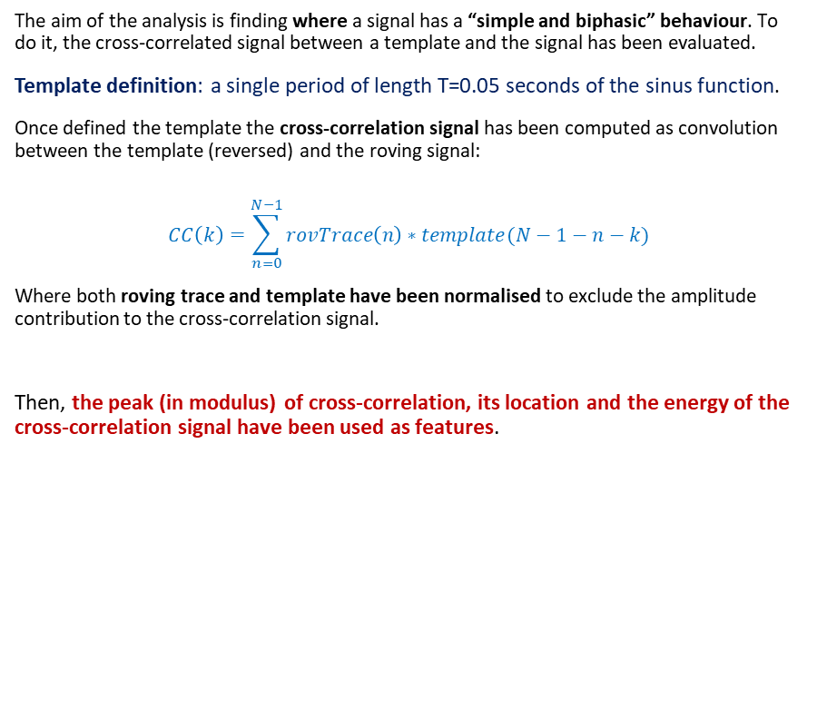

Template matching definition
The aim of the analysis is finding where a signal has a “simple and biphasic” behaviour. To do it, the cross-correlated signal between a template and the signal has been evaluated.
Template definition: a single period of length T=0.05 seconds of the sinus function.
Once defined the template the cross-correlation signal has been computed as convolution between the template (reversed) and the roving signal:
$$CC\left(k\right)=\sum_{n=0}^{N−1}{rovTrace\left(n\right)∗template(N−1−n−k)}$$
Where both roving trace and template have been normalised to exclude the amplitude contribution to the cross-correlation signal.
Then, the peak (in modulus) of cross-correlation, its location and the energy of the cross-correlation signal have been used as features.
$$(peak,t_{peak})$$

Slide 11
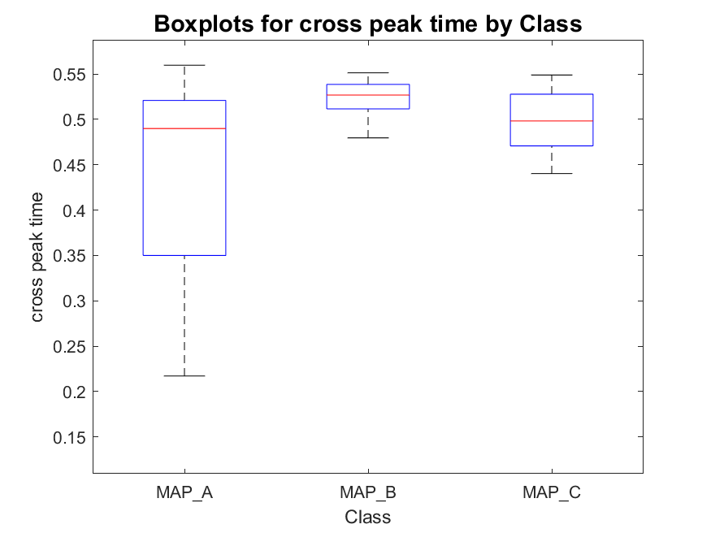
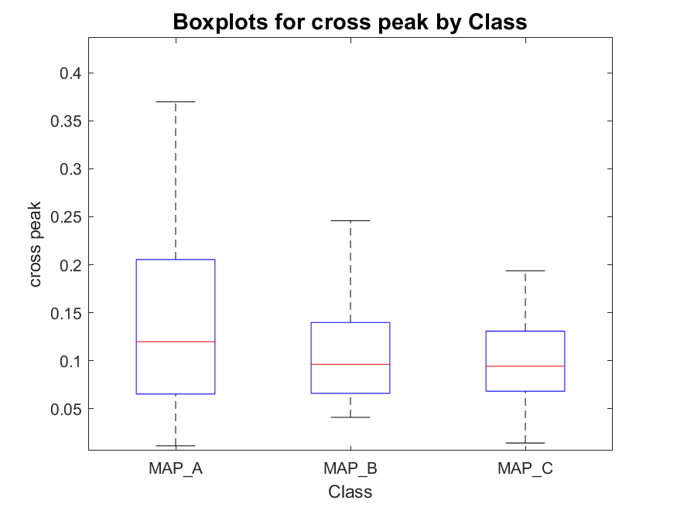
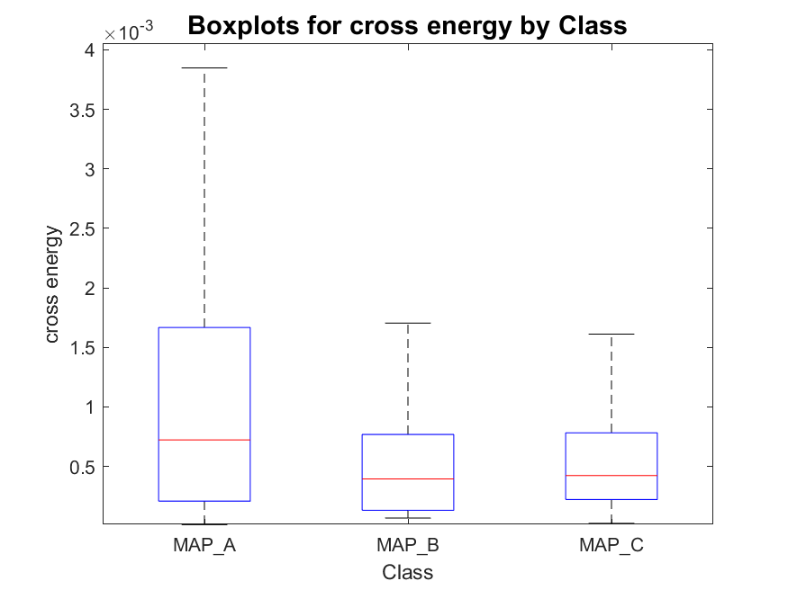
Energy of whole cross signal, atrial and ventricular phases
MAP_A has:
- 22 signals with one peak
- 254 signals with two peaks
- 387 signals with three peaks
total : 663
MAP_B has:
- 0 signals with one peak
- 41 signals with two peaks
- 53 signals with three peaks
total : 94
MAP_C has:
- 2 signals with one peak
- 12 signals with two peaks
- 76 signals with three peaks
total : 90

Slide 12
Outline
Feature extraction
Envelope features
Template matching features
Short time Fourier transformation definition and analysis
Classification
Knowledge based classifier: recap
Improved Knowledge based classifier
Tree classifier: whole set of features optimal subset of features
Conclusions

Slide 13
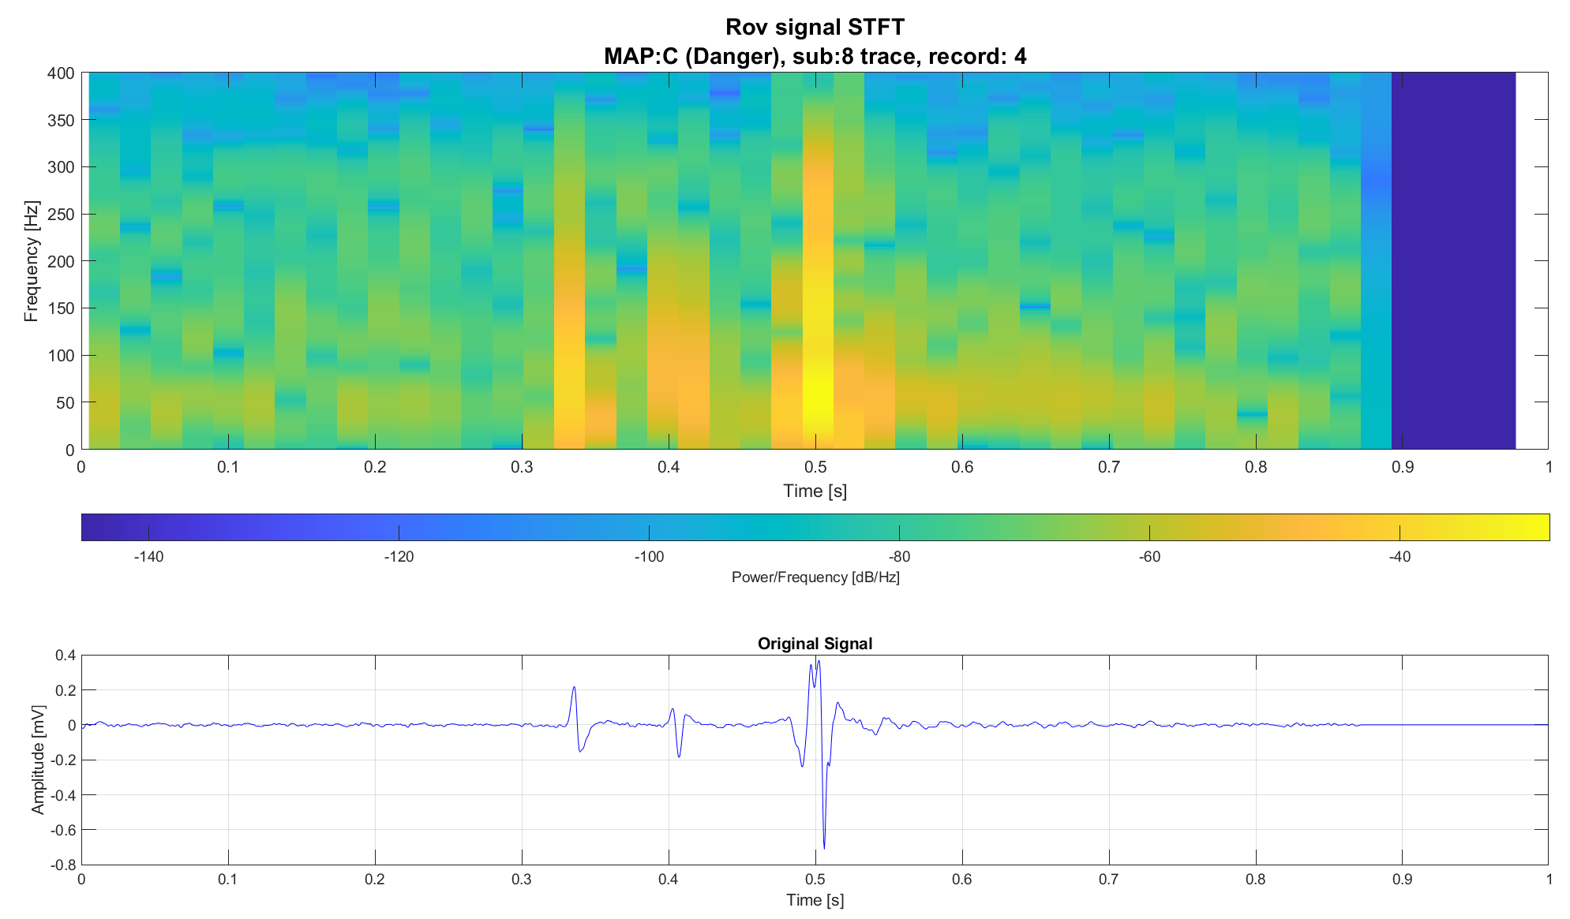
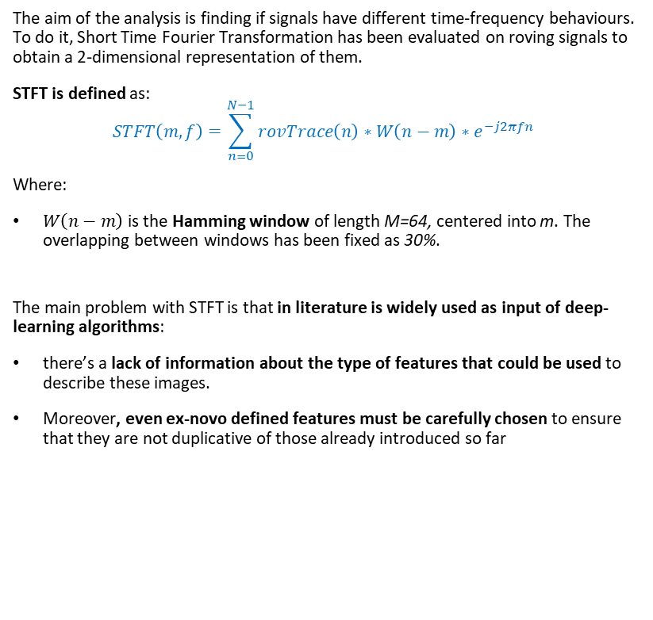
STFT definition
The aim of the analysis is finding if signals have different time-frequency behaviours. To do it, Short Time Fourier Transformation has been evaluated on roving signals to obtain a 2-dimensional representation of them.
STFT is defined as:
$$STFT\left(m,f\right)=\sum_{n=0}^{N−1}{rovTrace\left(n\right)∗W\left(n−m\right)∗e^{−j2πfn} }$$
Where:
$W\left(n−m\right)$ is the Hamming window of length M=64, centered into m. The overlapping between windows has been fixed as 30%.
The main problem with STFT is that in literature is widely used as input of deep-learning algorithms:
there’s a lack of information about the type of features that could be used to describe these images.
Moreover, even ex-novo defined features must be carefully chosen to ensure that they are not duplicative of those already introduced so far

Slide 14
Outline
Feature extraction
Envelope features
Template matching features
Short time Fourier transformation definition and analysis
Classification
Knowledge based classifier: recap
Improved Knowledge based classifier
Tree classifier: whole set of features optimal subset of features
Conclusions

Slide 15
Knowledge based classifier: recap
For each roving trace:
Divide the trace in three regions (Atrial: t<0.38s, His: 0.38<t<0.42 and Ventricular: 0.42<t<0.6);
Compute the absolute value of each region and find the maximum;
Then, apply the following rules:
KB V0: atrial peak thresholding
KB V1: atrial/ventricular ratio (Th: 05)
Is the His Peak above threshold?
No
Is the atrial peak > 0.5 mV?
No
Is the His Peak above threshold?
No
Is the atrial/ventricular peak ratio >threshold?
No
MAP B
MAP B
Yes
Yes
Yes
Yes
MAP C
MAP A
MAP C
MAP A

Slide 16
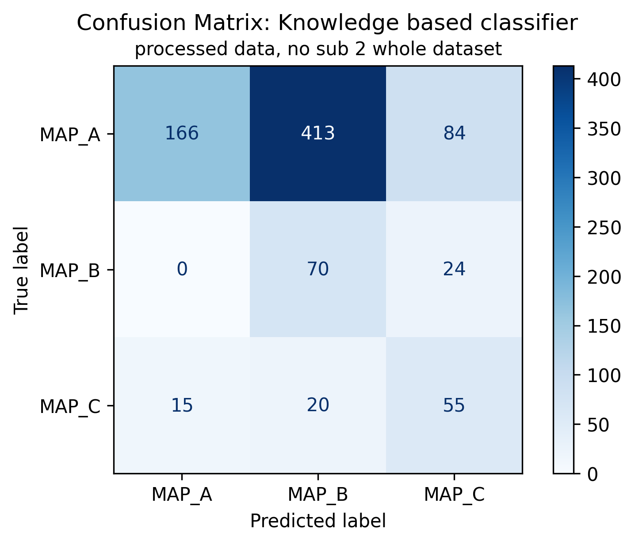
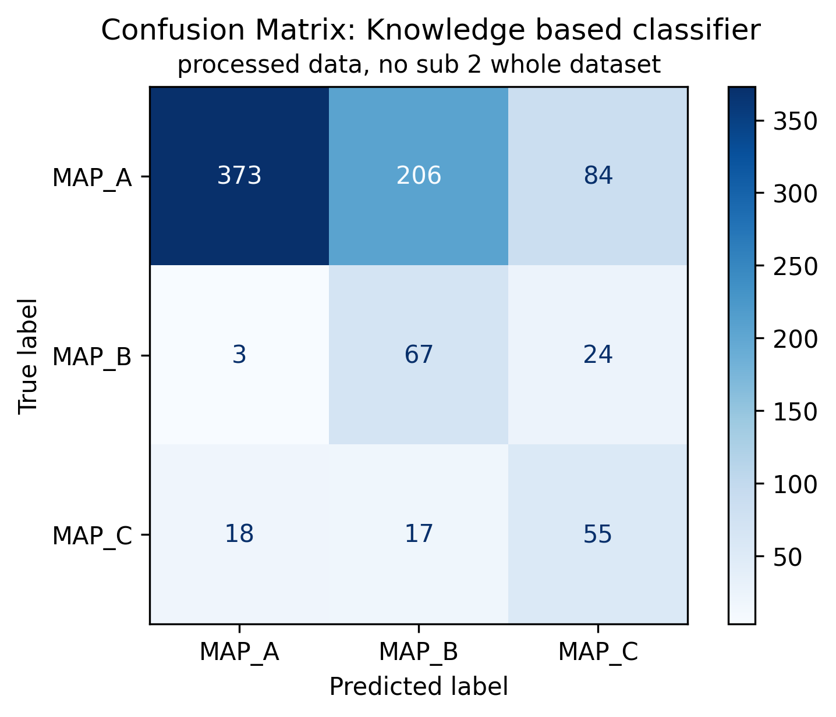
KB classifier V0 and V1: previous results
KB V1: atrial/ventricular ratio, th=0.5
KB V0: Atrial peak threshold
KB V1: atrial/ventricular ratio, th=0.5
Of 847 signals:
663 are ineffective (MAP A, 78.28%);
94 are effective (MAP B, 11.1%);
90 are dangerous (MAP C, 10.63%);

Slide 17
Outline
Feature extraction
Envelope features
Template matching features
Short time Fourier transformation definition and analysis
Classification
Knowledge based classifier: recap
Improved Knowledge based classifier
Tree classifier: whole set of features optimal subset of features
Conclusions

Slide 18
Knowledge based classifier with envelope-based features
For each roving trace, use the envelope to evaluate active areas. Then:
Improved KB V0: peaks thresholds and position
Improved KB V1: peaks thresholds and atrial/ventricular ratio
Is third peak >0.021?
No
Is peak_1_pos<0.49
No
Is third peak >0.021?
No
Is atrial_ventricular_ratio >0.09?
No
MAP B
MAP B
Yes
Yes
Yes
Yes
MAP C
MAP A
MAP C
MAP A

Slide 19
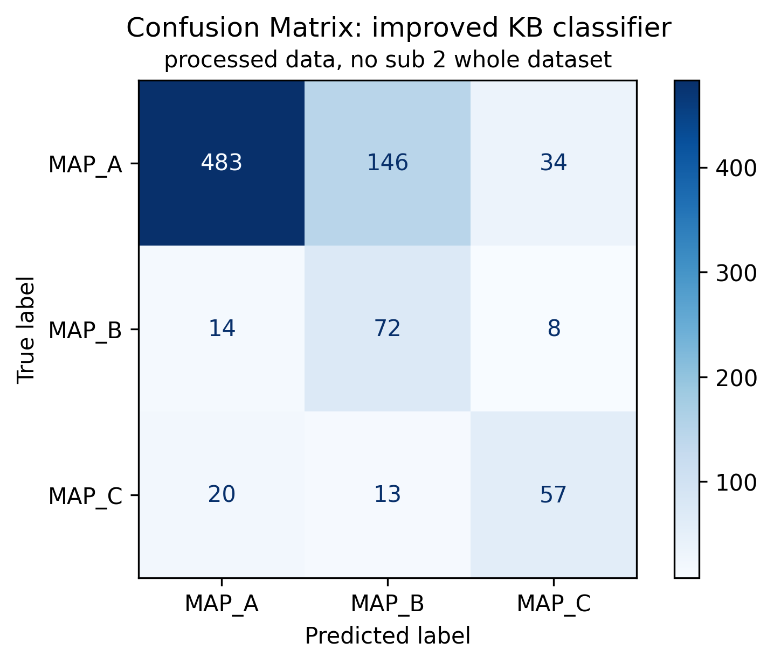
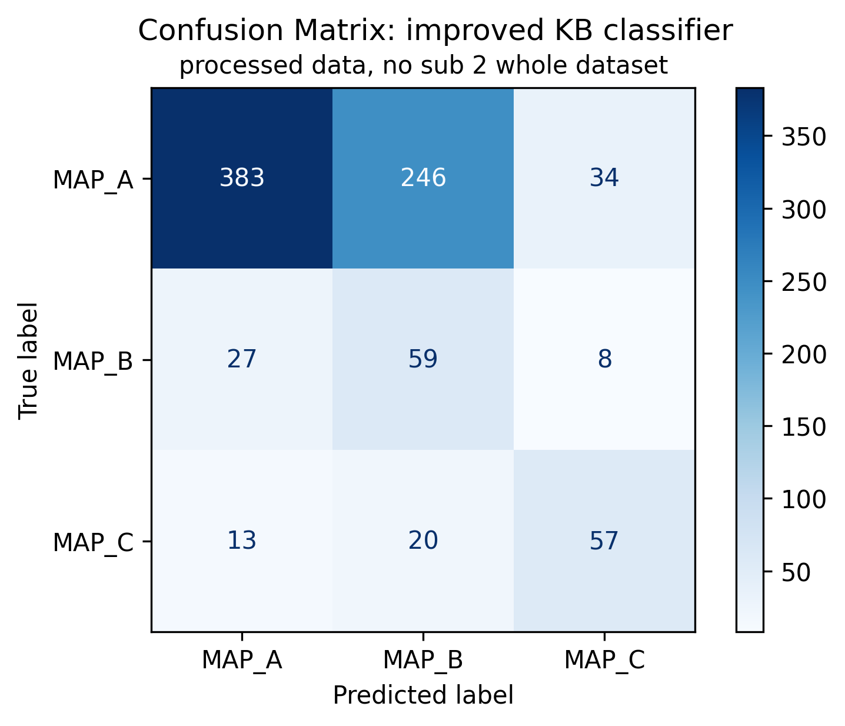
Knowledge based classifier with envelope-based features
Improved KB V0: peaks thresholds and position
Improved KB V0: peaks thresholds and position
Improved KB V1: peaks thresholds and atrial/ventricular ratio
Respect to KB V1:
Higher precision for all maps
Less misclassified MAP C and MAP B signals
Slightly increased number of misclassified signals from MAP C to MAP A and for MAP B to MAP A (left column, last 2 boxes)
Of 847 signals:
663 are ineffective (MAP A, 78.28%);
94 are effective (MAP B, 11.1%);
90 are dangerous (MAP C, 10.63%);

Slide 20
Outline
Feature extraction
Envelope features
Template matching features
Short time Fourier transformation definition and analysis
Classification
Knowledge based classifier: recap
Improved Knowledge based classifier
Tree classifier: whole set of features optimal subset of features
Conclusions

Slide 21
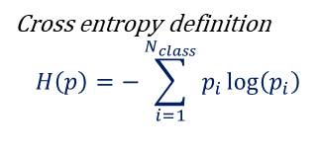
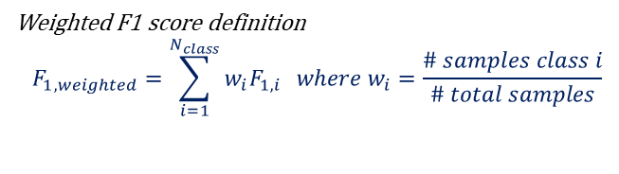
Machine learning approach: tree classifier
Machine learning approaches allow to model data with statistical models trained on a set of features.
Rules and relationships are not a priori fixed
Possible deeper feature relationship evaluation
Possibility of finding new insights on data
…
Tree models are among the most easily explained, therefore the choice felt on them.
Mathematical rules are defined into each node to minimize the impurity of the following level
An “impurity measure” is required
Tuning the depth of the three is required
LOPOCV is used as validation technique
Tree classifiers
Tree 1: whole feature set
Tree 2: relevant feature set
Impurity measure: Cross entropy
Impurity measure: Cross entropy
Depth: maximising weighted f1 score
Depth: maximising weighted f1 score
Cross entropy definition
$$H\left(p\right)=−\sum_{i=1}^{N_{class}}{p_{i}\log\left(p_{i}\right)}$$
Weighted F1 score definition
$$F_{1, weighted}=\sum_{i=1}^{N_{class}}{w_{i}F_{1,i} } where w_{i}=\frac{\# samples class i}{\# total samples}$$

Slide 22
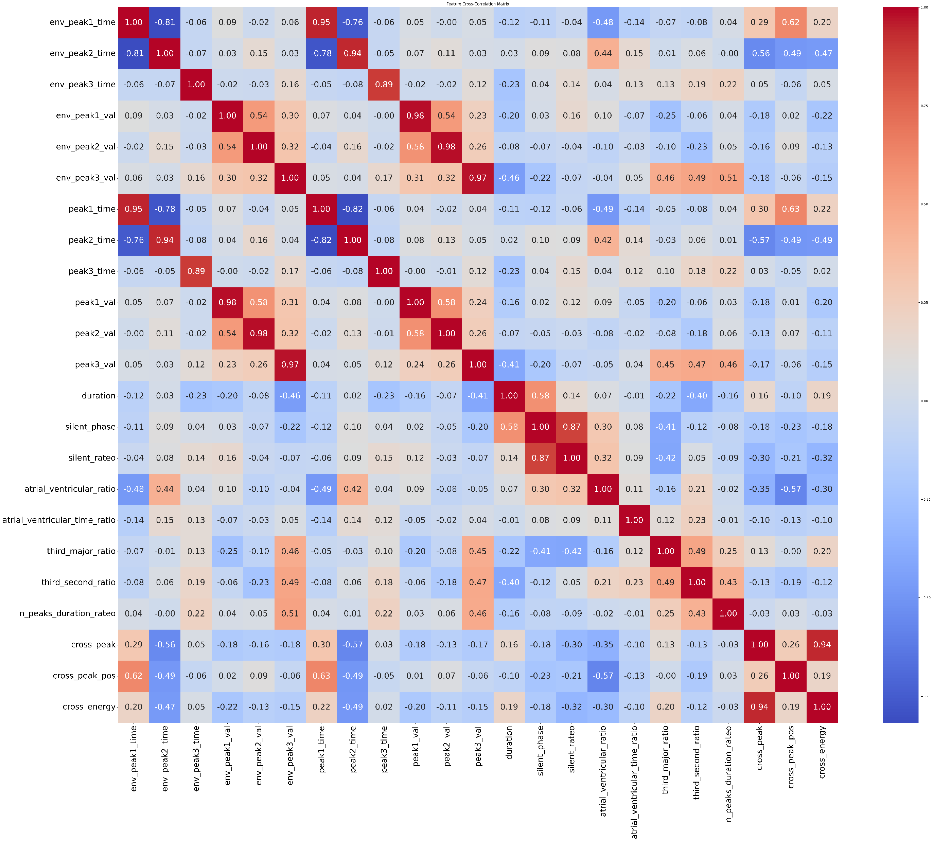
Feature selection: correlation matrix
To avoid the usage of features correlated between each other, correlation matrix has been computed.
Prior to classification, some features have been re moved according to the correlation matrix:
Envelope peaks values and time
silent_rateo
cross_energy

Slide 23
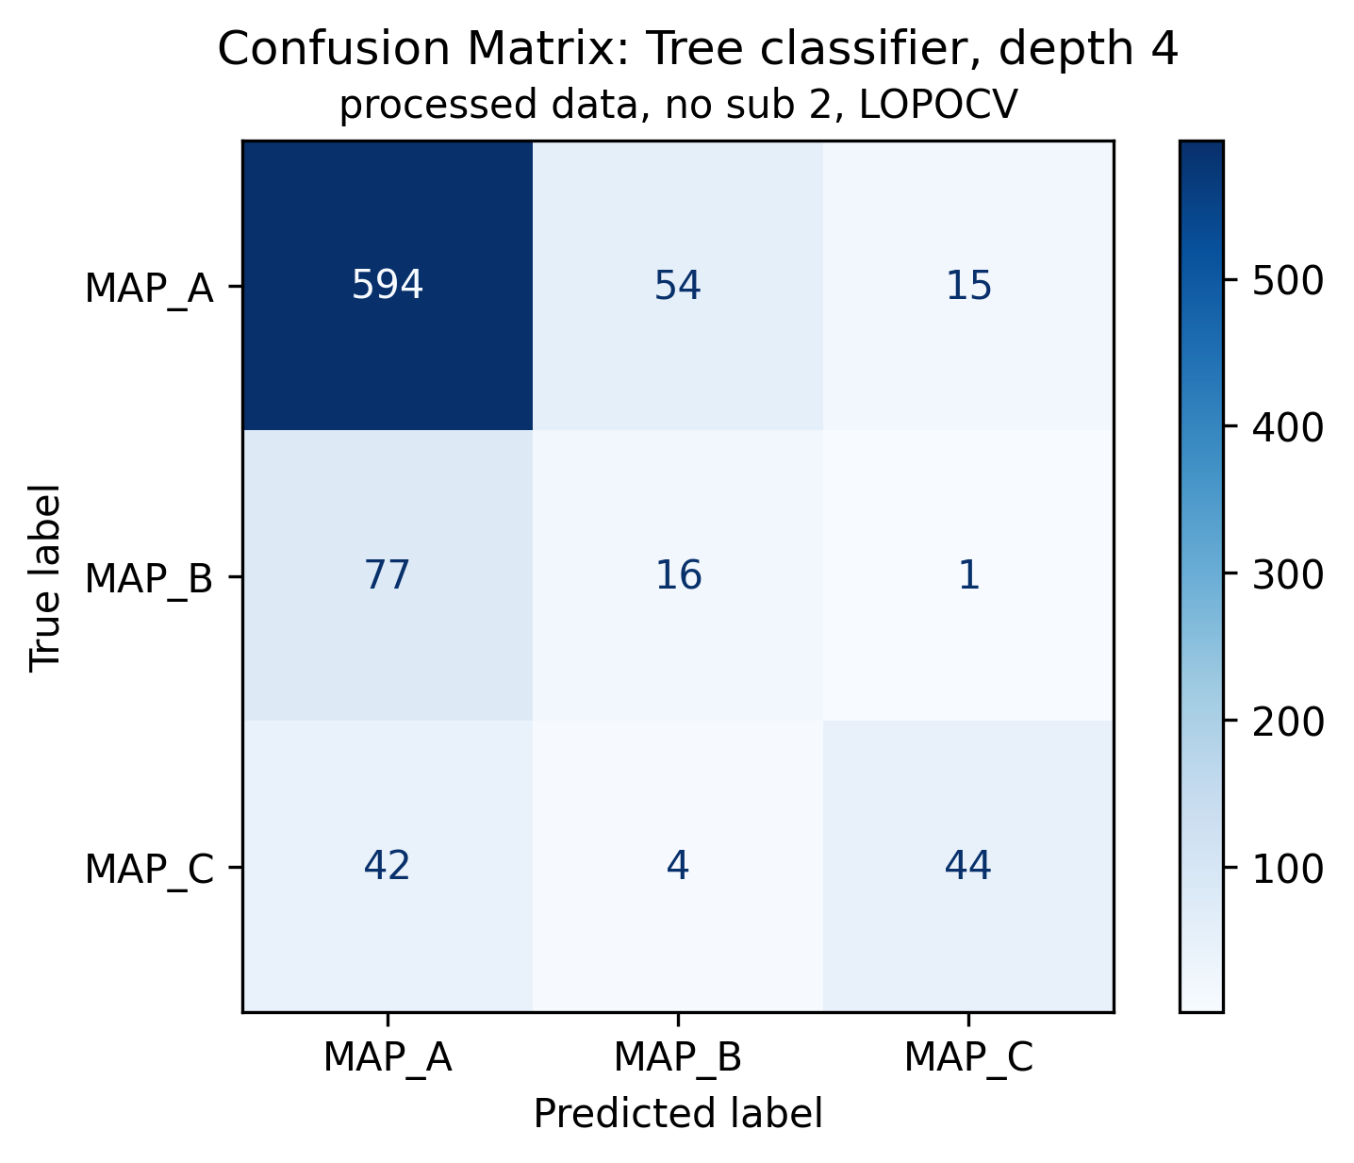
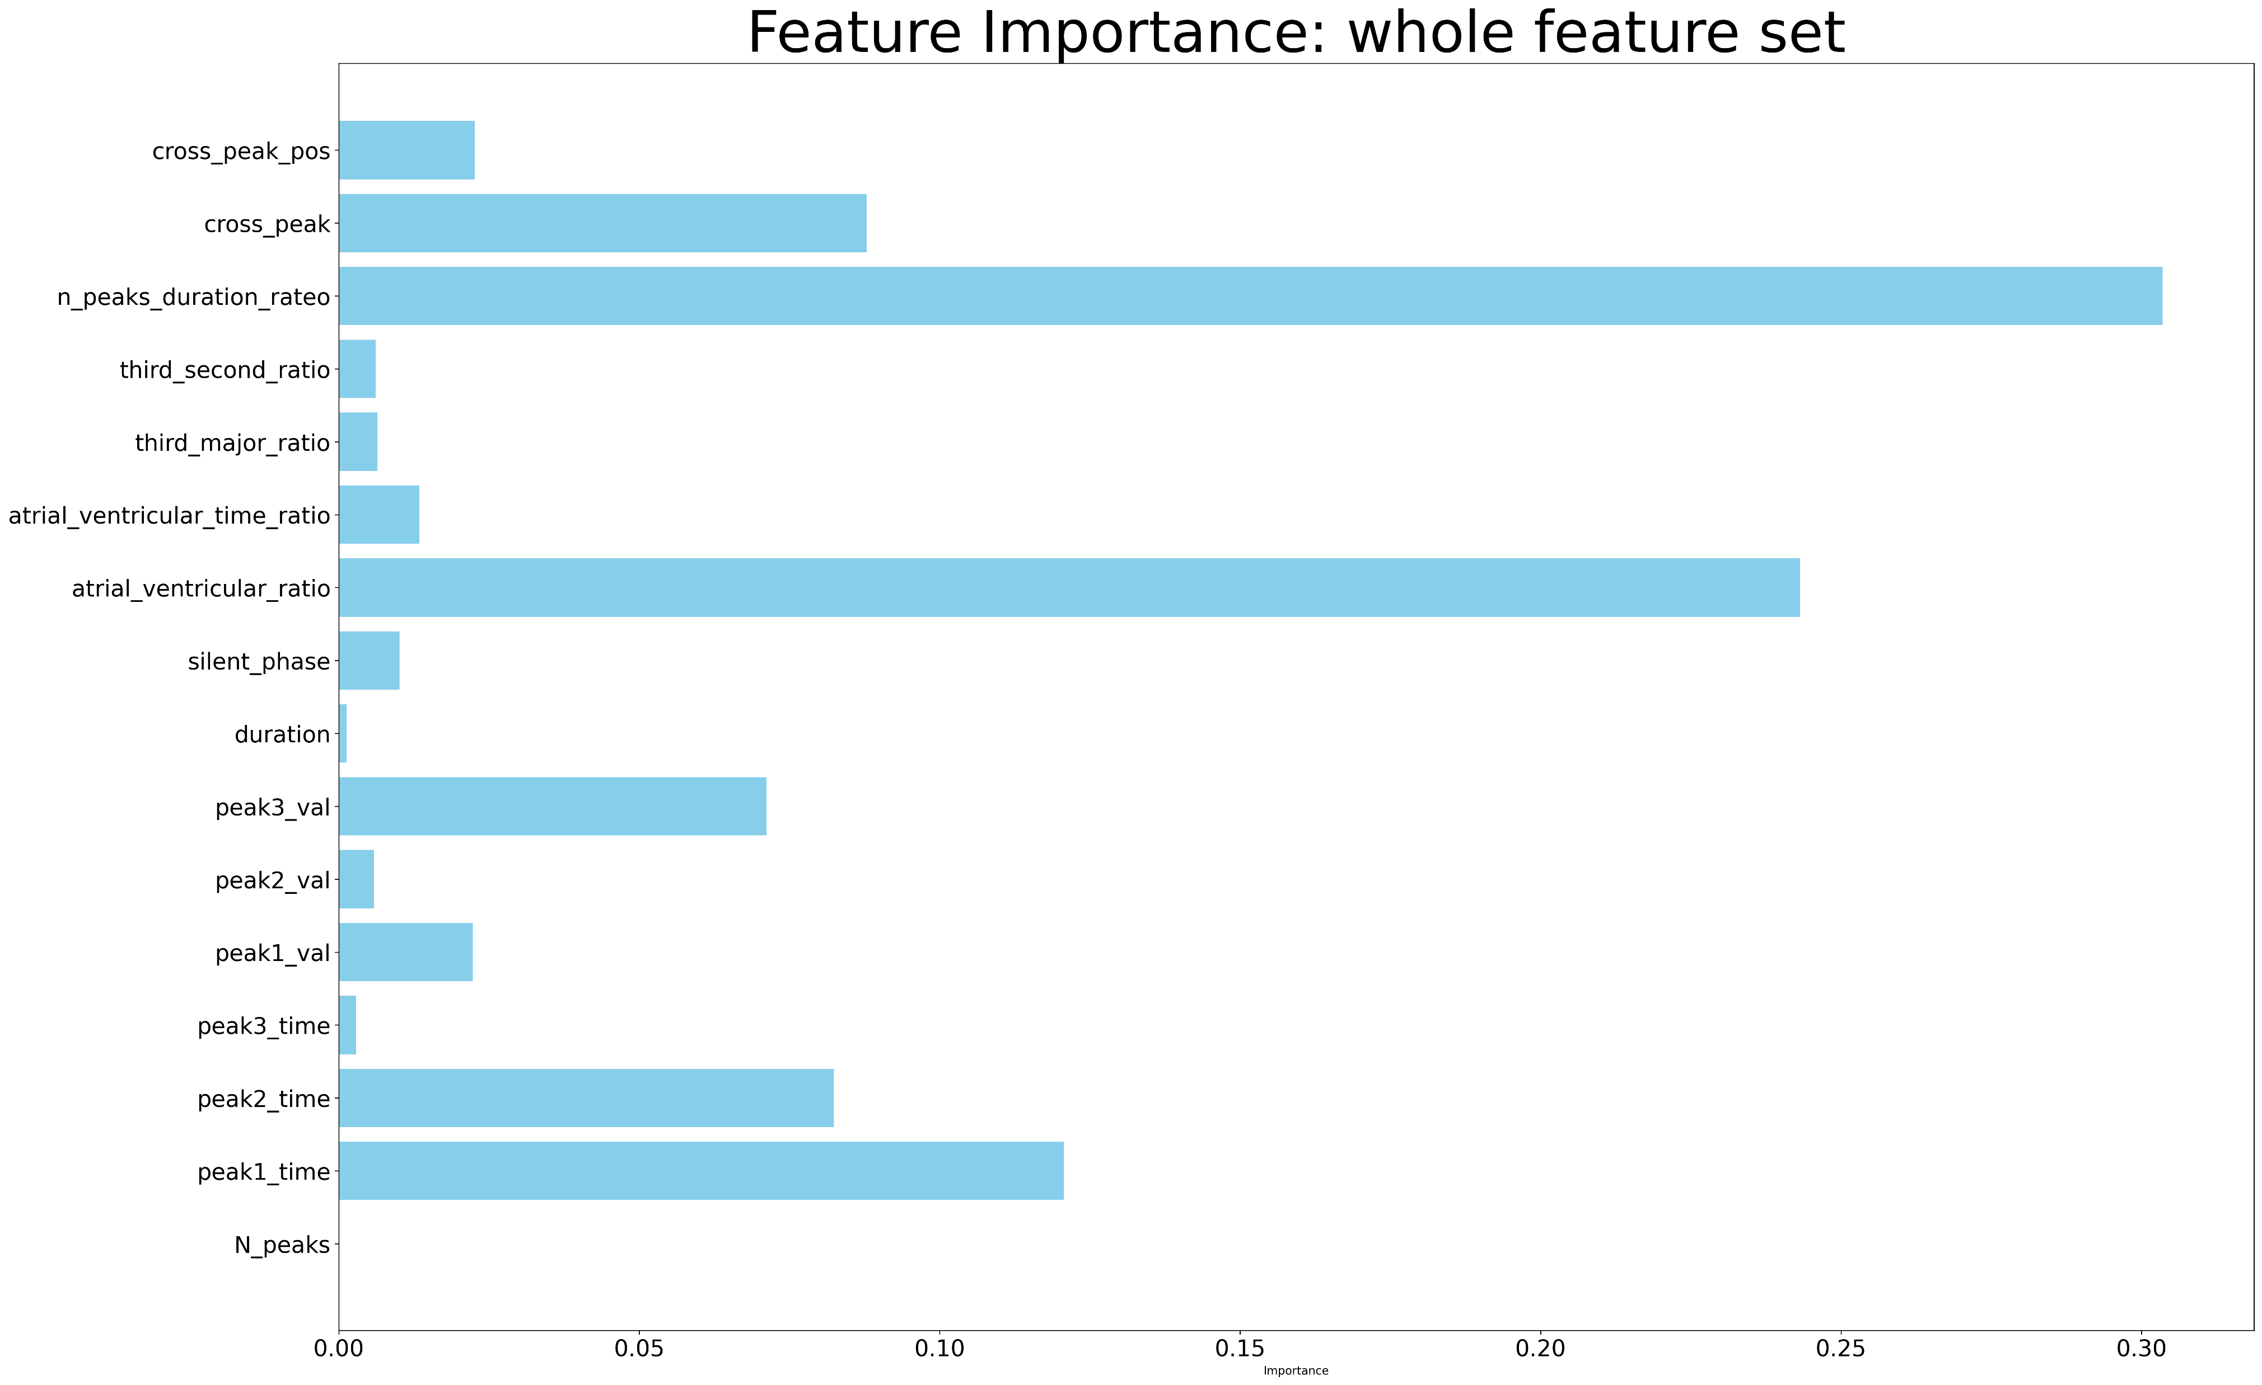
Tree classifier V1: results
Tree 1: whole feature set
Of 847 signals:
663 are ineffective (MAP A, 78.28%);
94 are effective (MAP B, 11.1%);
90 are dangerous (MAP C, 10.63%);

Slide 24
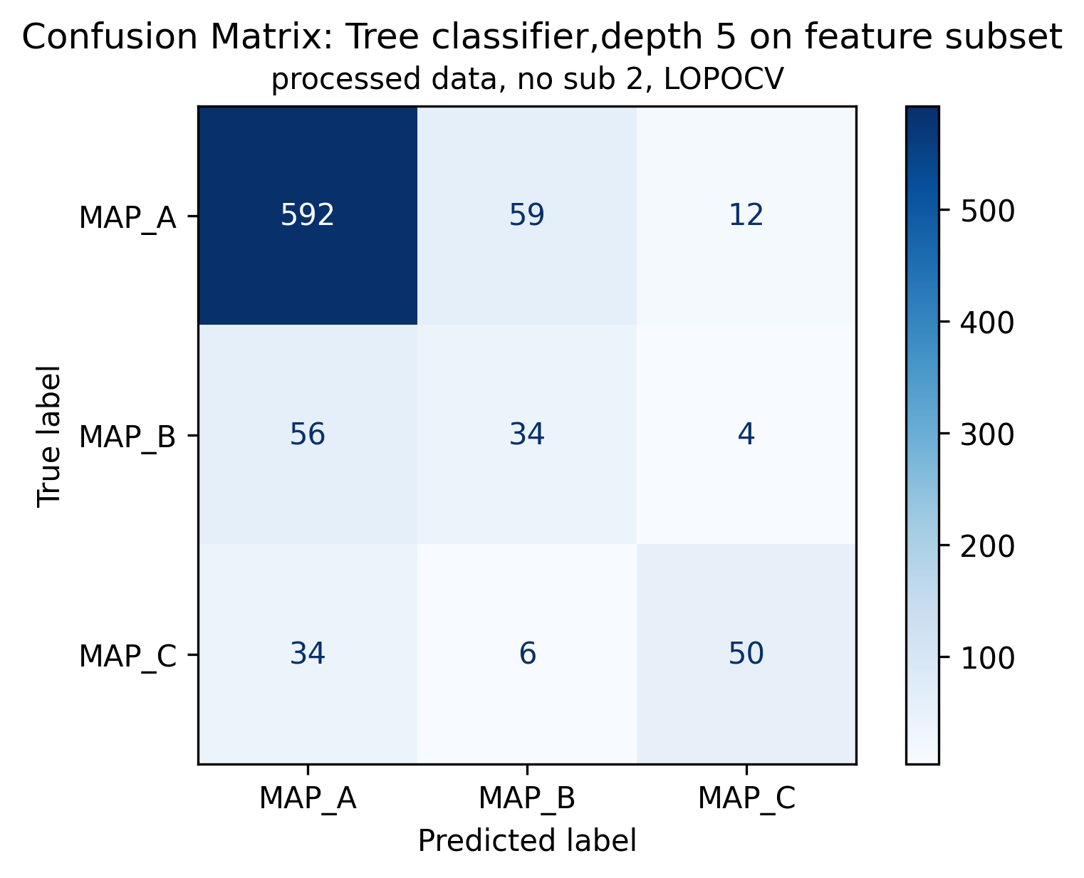
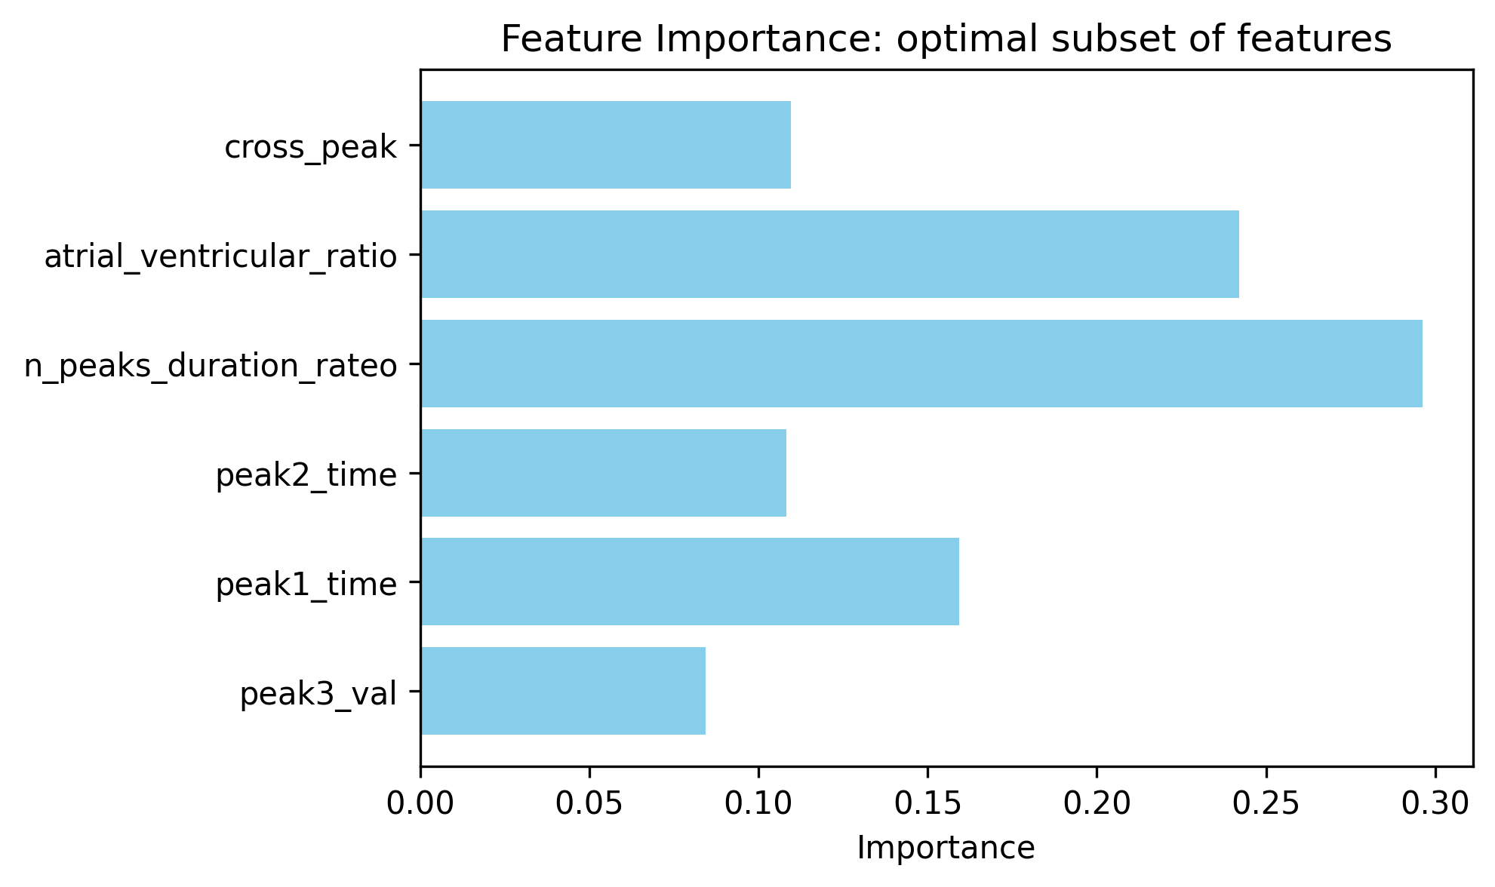
Tree classifier V2 – subset of features: results
Tree 2: relevant features set
Of 847 signals:
663 are ineffective (MAP A, 78.28%);
94 are effective (MAP B, 11.1%);
90 are dangerous (MAP C, 10.63%);

Slide 25
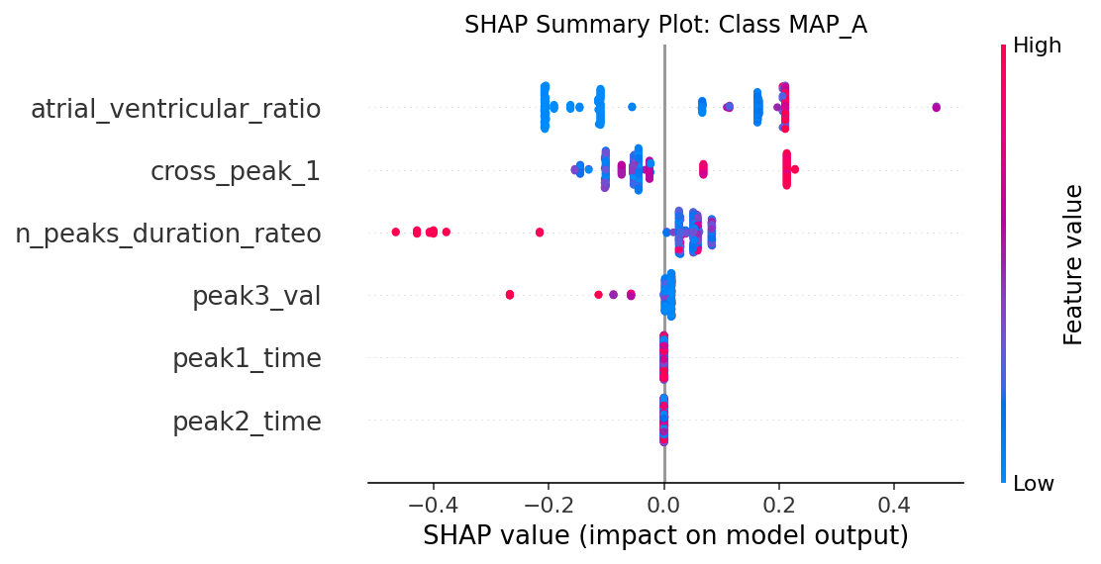
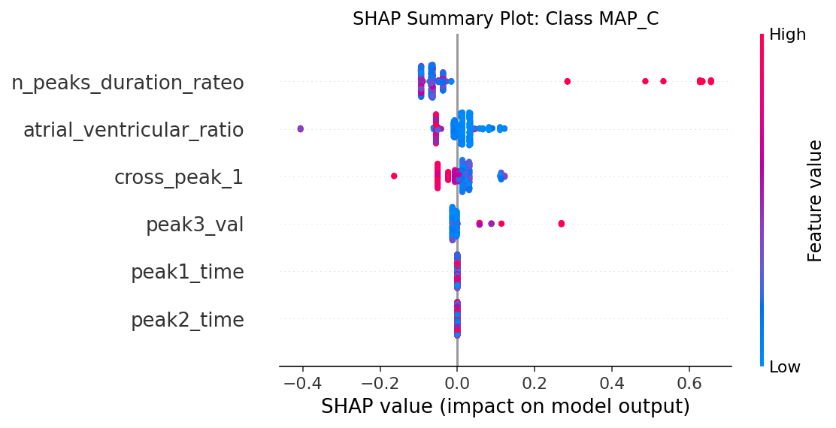
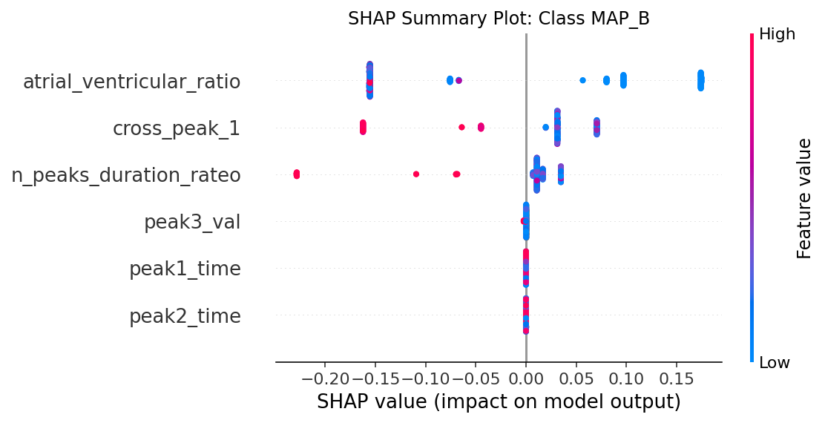
SHAP analysis on feature subset

Slide 26
Tree classifiers: LOPOCV confusion matrix comparison
Tree 1: whole feature set
Tree 2: relevant feature subset
Of 847 signals:
663 are ineffective (MAP A, 78.28%);
94 are effective (MAP B, 11.1%);
90 are dangerous (MAP C, 10.63%);

Slide 27
Knowledge based or tree?
Improved KB V0: peaks thresholds and position
Tree 2: relevant feature subset

Slide 28
Outline
Feature extraction
Envelope features
Template matching features
Short time Fourier transformation definition and analysis
Classification
Knowledge based classifier: recap
Improved Knowledge based classifier
Tree classifier: whole set of features optimal subset of features
Conclusions

Slide 29
Conclusions
Two feature extraction pipelines based on envelope analysis and template matching have proposed:
Envelope features provides information on peaks positions and active areas of the signal
Template matching features provides information on signal morphology
Moreover, STFT usage has been explored but features have not been evaluated for the time being as they would have to be meticulously defined from scratch. Otherwise, redundant information would be introduced.
Other similar studies used DWT based features (similar to the one introduced with TM), autocorrelation-based features, self-similarity features and complexity-analysis based features.
Then, three models have been evaluated:
An improved Knowledge based model based on envelope features
A decision tree (LOPO cross validation) trained onto the whole feature set
A decision tree (LOPOCV) trained onto an optimized feature set
Results are encouraging but higher performance are required, specially into MAP A/MAP B discrimination.
Future steps could be:
Defining new features based on a second template (more complex)
Computing new features as envelope peaks area, ApEN, Mutual Information
Defining and analyzing spectral/STFT features

